Slide 1
GammaLib A versatile framework for the analysis of astronomical gamma-ray data

Slide 2
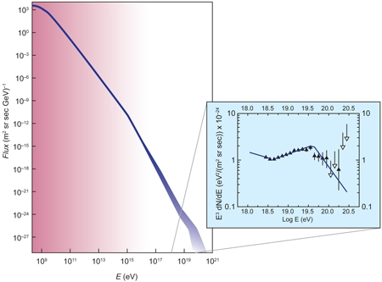
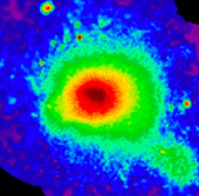
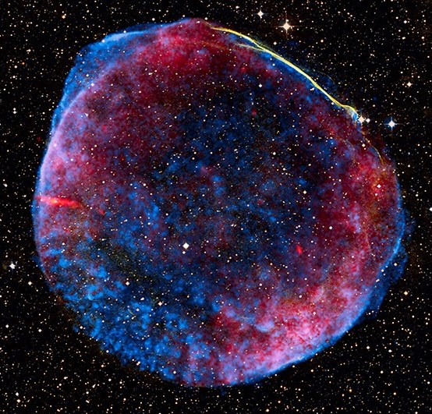
Understanding the non-thermal Universe
solar modulation
extra-
galactic
Pulsars
knee
GRB
galactic
PWNs
Galaxy clusters
ankle
GZK cut-off
SNRs
AGNs
novae
binaries
Starbursts

Slide 3
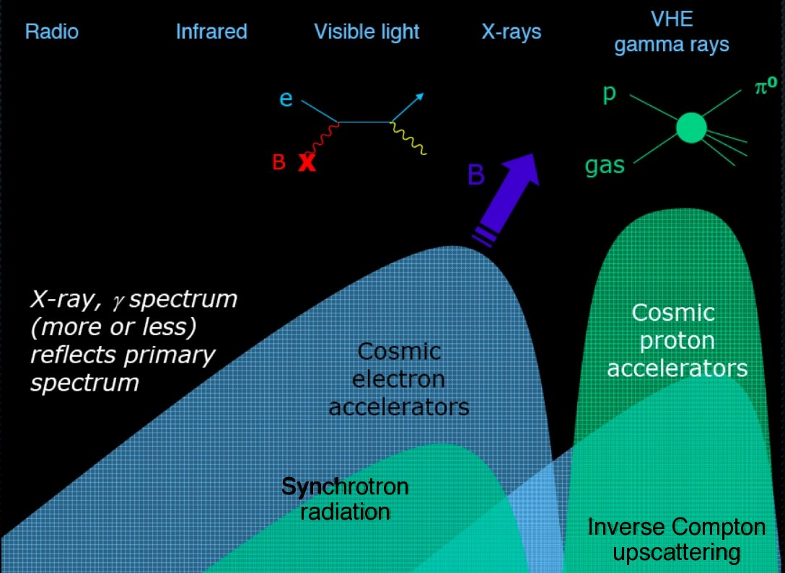
An inherent multi-wavelength endeavor
Non-thermal particles emit over the entire electromagnetic spectrum

Slide 4
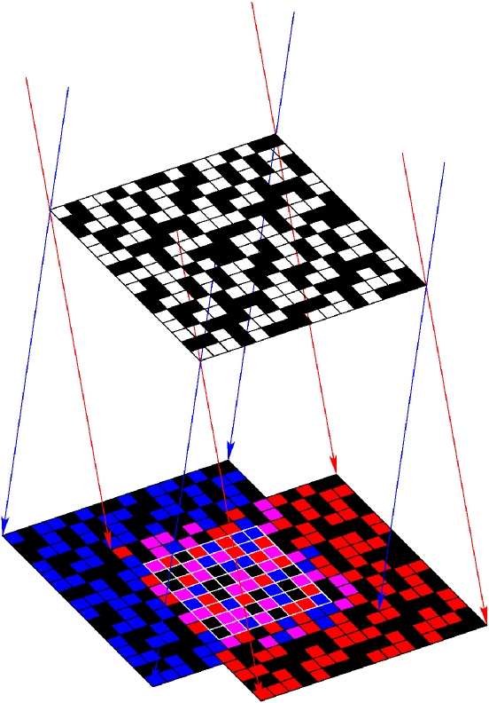
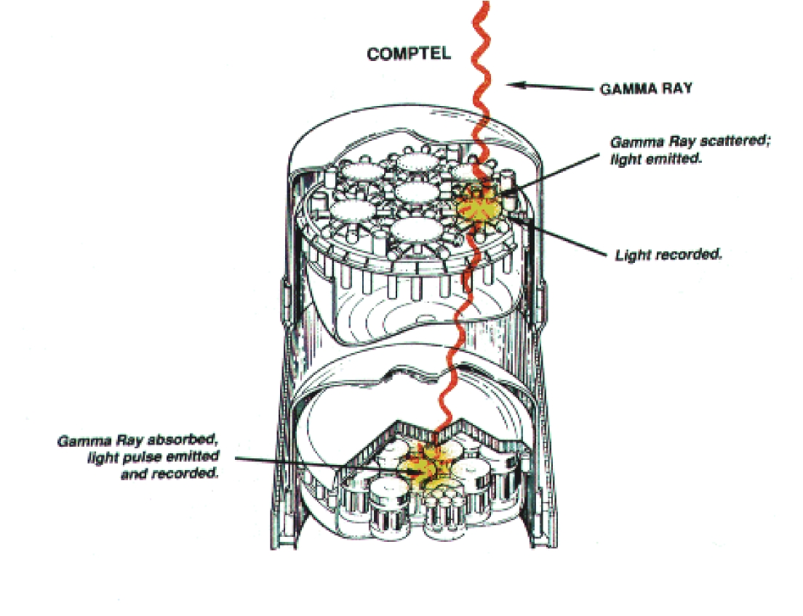
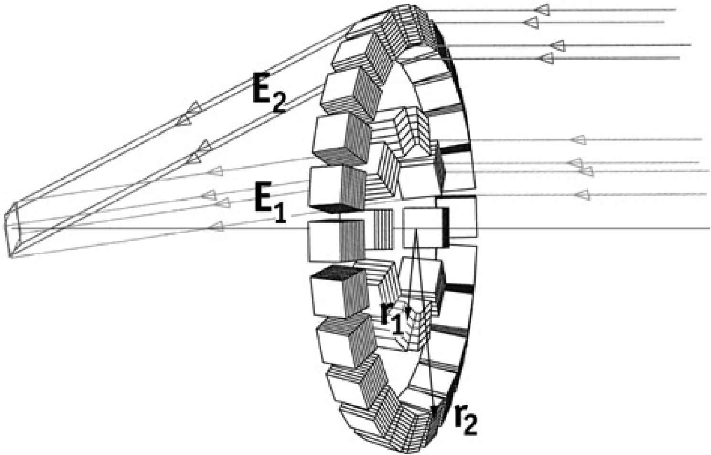
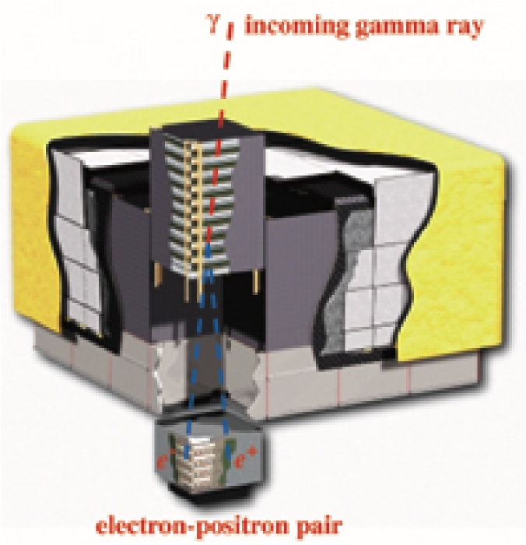
Observing gamma rays
keV
MeV
GeV
TeV

Slide 5
Observing gamma rays
keV
MeV
All instruments measure individual photons
Localization
Energy
Time
(Polarization)
GeV
TeV

Slide 6
What is GammaLib?
A self-contained, instrument independent, open source, multi-platform C++ library that implements all code required for high-level science analysis of astronomical gamma-ray data.
Self-contained: does not depend on external libraries (except for cfitsio for FITS file access)
Instrument independent: potentially supports any high-energy astronomy instrument; enables simultaneous multi-instrument analysis
Open source: source code from http://sourceforge.net/projects/gammalib/
Multi-platform: compiles on any POSIX compliant Unix platform (Linux, Mac OS X, OpenSolaris, FreeBSD)
C++ library: object oriented framework, uses class abstraction for instrument independence
Python module: fully binds in Python (swig)

Slide 7
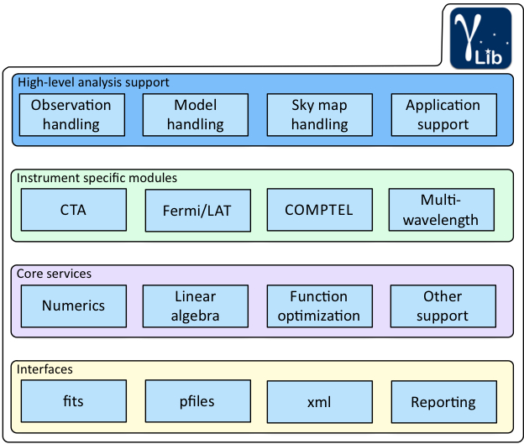
How is it organized?
Abstract
Extendable
Native
Compliant

Slide 8
How does it work?
Implement required functionalities as C++ classes.
Examples of C++ classes are:
GEnergy – unit independent energy value
GTime – time reference independent time value
GSkyDir – direction of sky (implicit conversion celestial/galactic)
GSkymap – skymap(s) – supports WCS and HEALPix
GFits – representation of FITS file (uses cfitsio)
GXml – representation of XML file
GObservations – collection of observations
GModel – Model describing a gamma-ray source or background
GMatrix – Matrix (supports, e.g., solution of linear equations)
GVector – Vector
GIntegral – Integration of functions
...

Slide 9
How does it work?
Use abstract virtual base classes to define an instrument independent interface to gamma-ray data and associated response information.
Examples of C++ classes are:
GObservation – interface to a single observation
GResponse – interface to response function
GEventAtom – interface to an event (unbinned analysis)
GEventBin – interface to an event bin (binned analysis)
...
Implement derived classes for each instrument to implement the instrument specific code.
Examples of C++ classes are:
GLATObservation – interface to a LAT observation (ft1/ft2)
GLATResponse – interface to LAT response function
GLATEventAtom – interface to an event (unbinned analysis)
GLATEventBin – interface to an event bin (binned analysis)
...

Slide 10
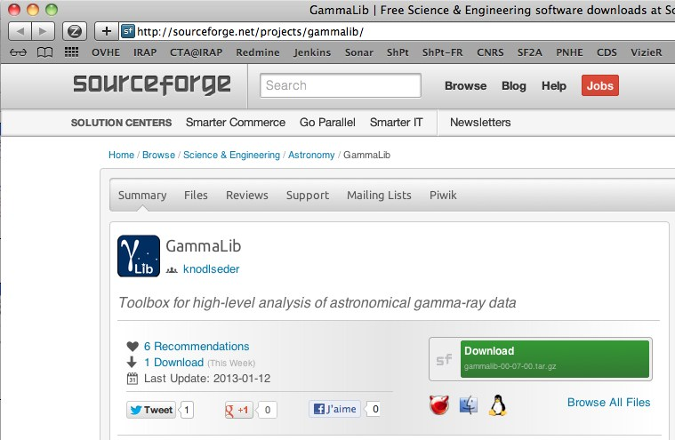
How to install it?
1. Get it
2. Compile it (and check it)
> ./configure
> make
> make check
===================
All 18 tests passed
===================
3. Install it
> [sudo] make install
4. Configure it
> export GAMMALIB=/usr/local/gamma
> source $GAMMALIB/bin/gammalib-init.sh

Slide 11
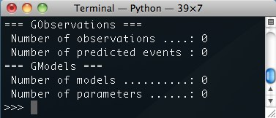
How to use it?
Build a C++ application:
#include <iostream>
#include "GammaLib.hpp"
int main(void) {
GObservations obs;
std::cout << obs << std::endl;
return 0;
}
Use python:
$ python
>>> from gammalib import *
>>> obs = GObservations()
>>> print obs

Slide 12
Development tools

Slide 13
Repository organization
$ git clone https://cta-git.irap.omp.eu/gammalib
Protected branches:
master – last release
release – release preparation
devel – developer branch, clones by default from here
integration – feature integration
Other branches: can be setup by any developer as required.
classical-analysis – the branch we’ll use as trunk this week
Gammalib development can also be based on Github:
https://github.com/gammalib/gammalib
read-only repository
synchronized with IRAP repository

Slide 14
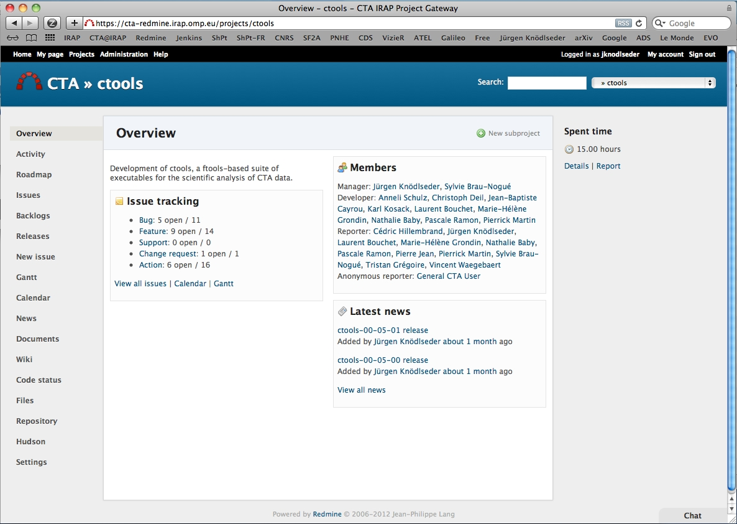
Organization

Slide 15
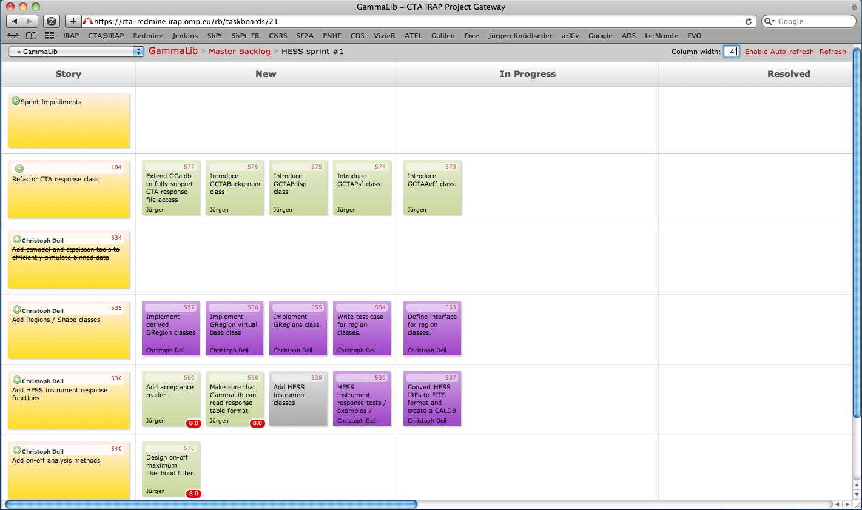
AGILE organization

Slide 16
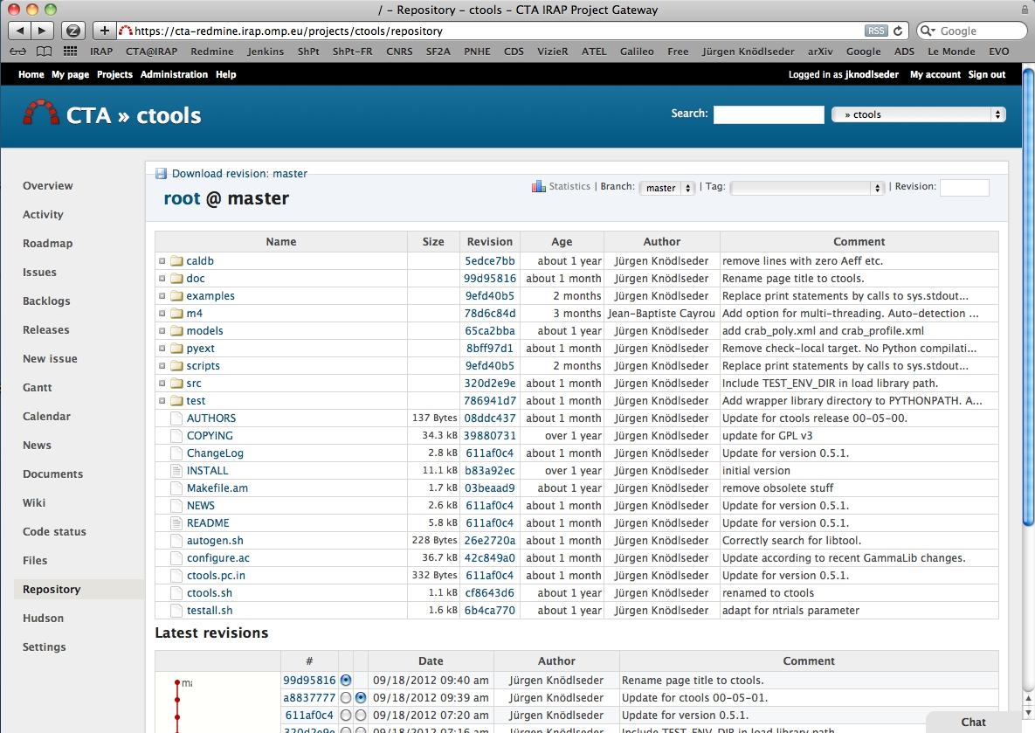
Repository access

Slide 17
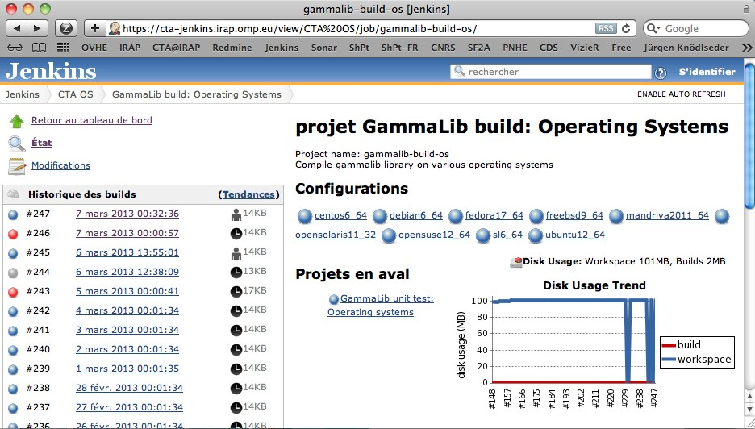
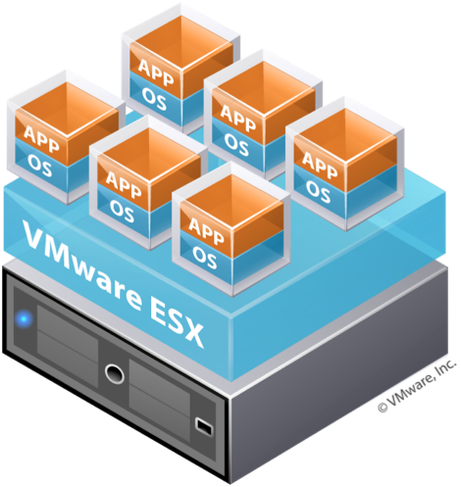
Code quality (continuous integration)
Continuous integration
(build, check, install, analysis)
Multi-platform, multi-compiler, 32/64 Bit, Python version, swig version, …
Virtual box with relevant OS

Slide 18
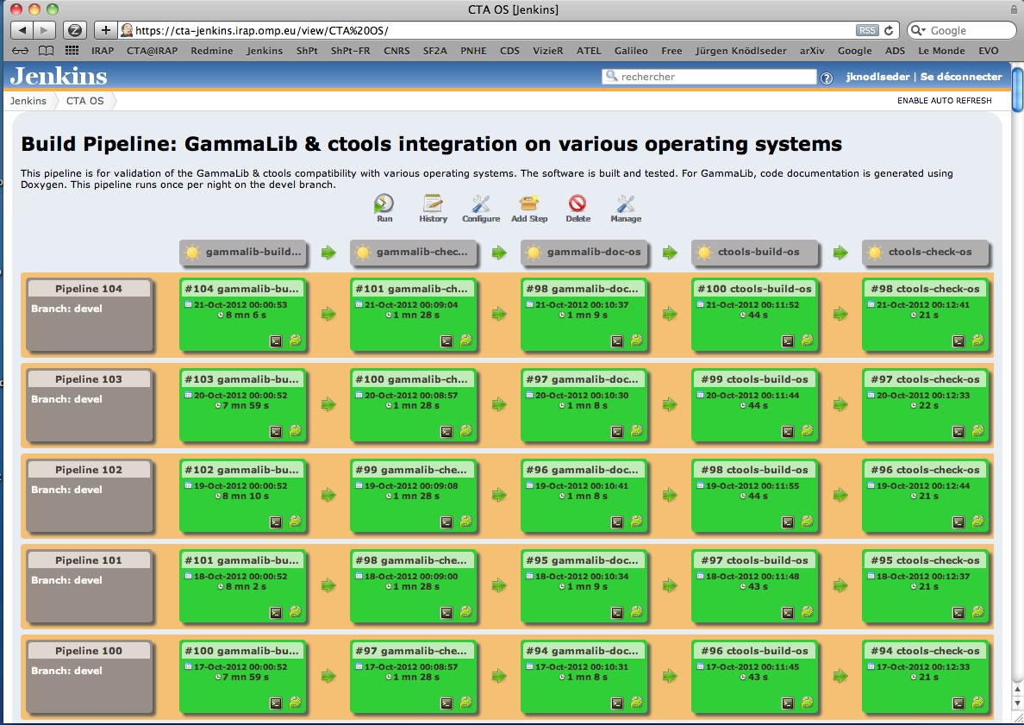
Build pipelines

Slide 19
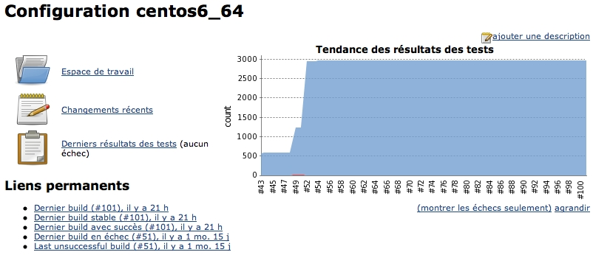
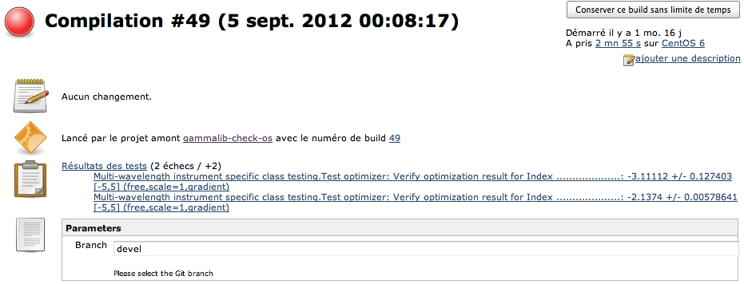
Unit testing

Slide 20
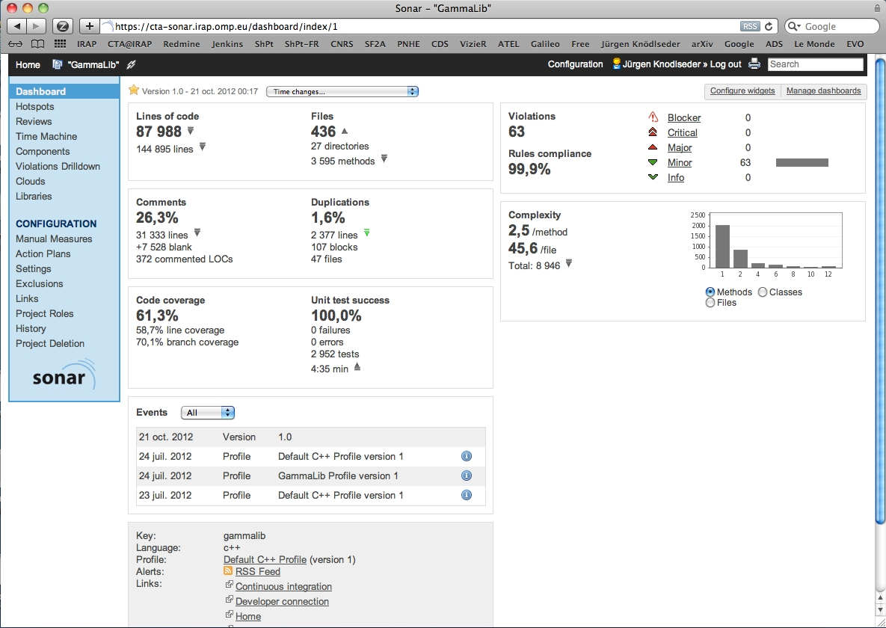
Code analysis

Slide 21
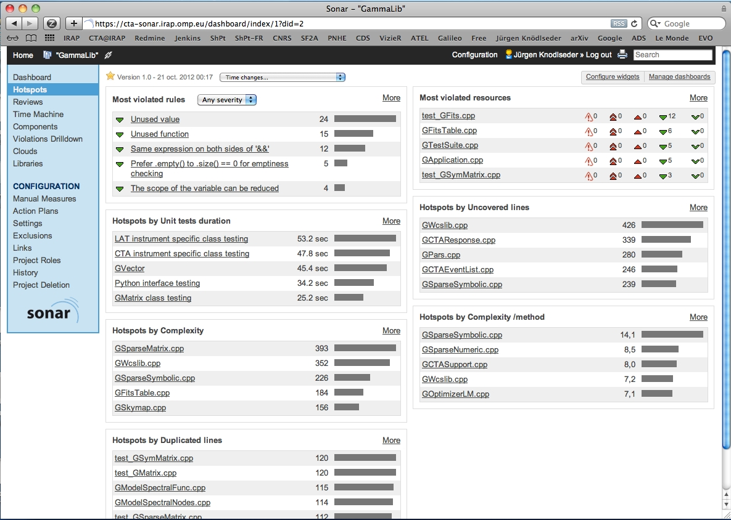
Hotspots

Slide 22
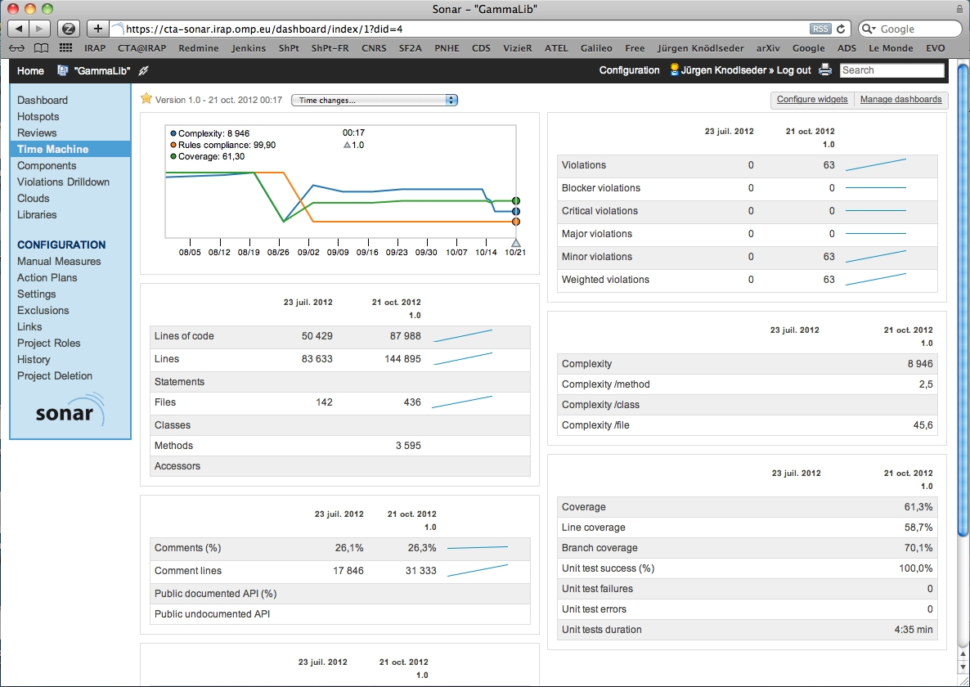
Evolutions

Slide 23
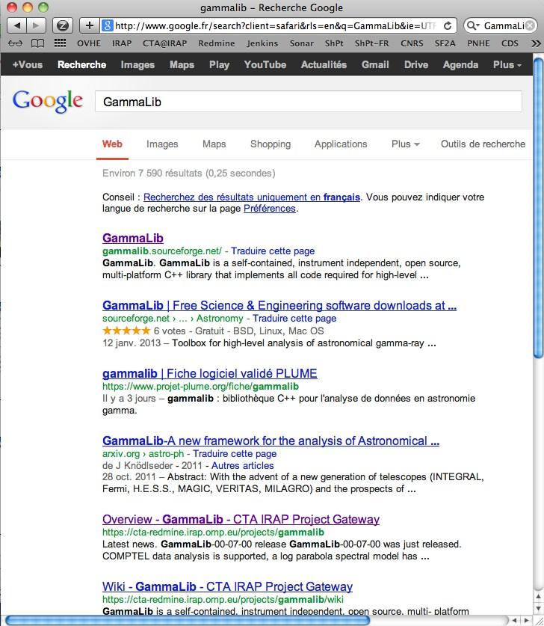
Want to know more?

Slide 24
Further program
GammaLib – a tour: walk through the organization of the library
Coding conventions: walk through the GEnergy class
Python embedding: swig at the GEnergy.i file
autoconf & automake: a quick tour of configure.ac and Makefile.am

