Slide 1
Gammalib and ctools.
Towards a common analysis framework for gamma-ray astronomy
Anneli Schulz, Rolf Bühler,
Jürgen Knödlseder, Michael Mayer, …
Fermi Collaboration Meeting
Montpellier, 01.09.2014

Slide 2


Introduction
High-level analysis framework
Framework allows to combine data from several instruments
Likelihood approach for VHE instruments
GammaLib available on http://gammalib.sourceforge.net
Ctools available on http://cta.irap.omp.eu/ctools/
Number of developers increasing
Presented at ICRC 2013 (for the CTA consortium)

Slide 3
GammaLib / ctools
GammaLib:
  self-contained, instrument independent, open source, multi-platform C++ library
  Likelihood analysis
Ctools:
  Set of executables, performing individual analysis steps
  Fermi-like analysis chain

Slide 4
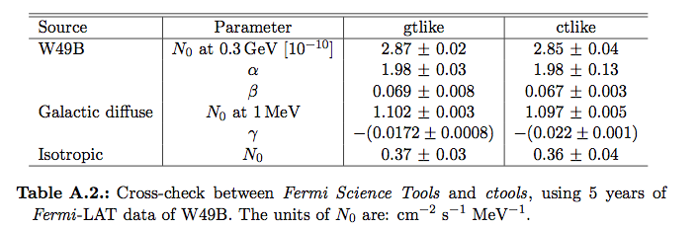
Analysis of Fermi-LAT data (P7REP) in ctools
All analysis steps until srcmaps are performed in Fermi Science Tools
Input for ctools: srcmaps, ltcube, expcube, IRFs, model
Nice agreement between the software frameworks

Slide 5
Cross-check Fermi Science Tools – ctools example: W49B
5 years of P7REP data, ctools points shifted by 10% to enhance visibility

Slide 6
VHE: Comparison of ctlike spectra to published ones

Slide 7
Combined fit of Fermi and H.E.S.S. data

Slide 8
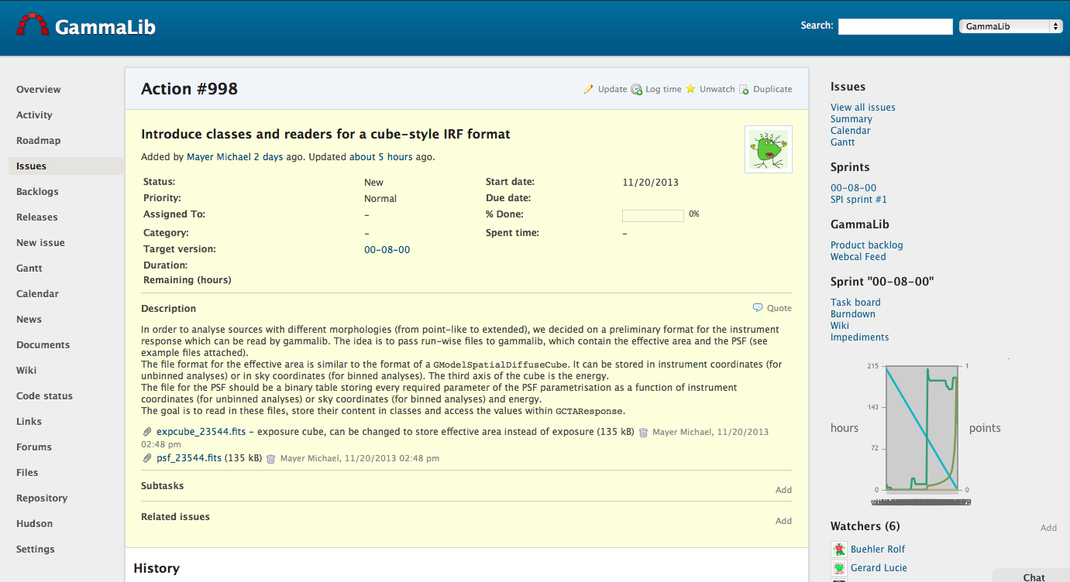
Project management and bug tracking – Redmine
https://cta-redmine.irap.omp.eu/projects/ctools/

Slide 9
Summary and Outlook
High-level analysis framework in the context of CTA, open-source
Fermi-like analysis for VHE
  Different background modeling approaches in progress
  Cross-checks with current IACT data in progress
Combined fits of multi-instrument data
Plans
GammaLib and ctools release 1.0 together with
Paper about software and basic functionality ( ~end of the year)
Fermi Data as show case ➔ Cat 2 paper

Slide 10
Combined fit of Fermi and H.E.S.S. data

