Slide 1
4th Coding Sprint
Short intro into GammaLib and ctools concepts
New features since last coding sprint
Instrument Response Functions
Goals of this sprint
Jürgen Knödlseder (IRAP)

Slide 2
1. Short intro into GammaLib and ctools concepts

Slide 3
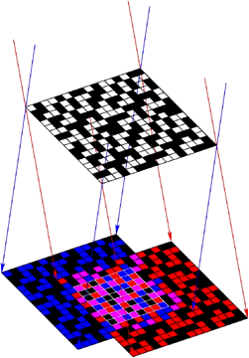
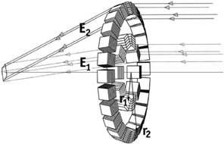
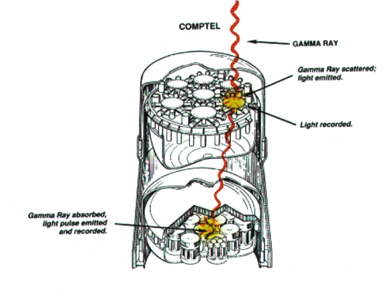
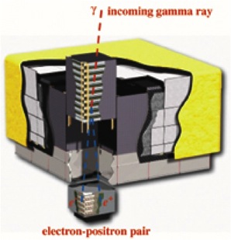
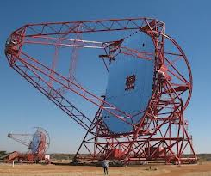
Concept
MeV
keV
GeV
TeV
All gamma-ray telescopes measure individual photons as events =>
Handle events from gamma-ray telescopes in an abstract and common software framework.
Existing high-energy analysis frameworks share a number of common features (FITS files, likelihood fitting, modular design).
… is the client that uses the bricks provided by
CTA specific
generic
… to build a set of analysis executables for CTA (and alike)

Slide 4
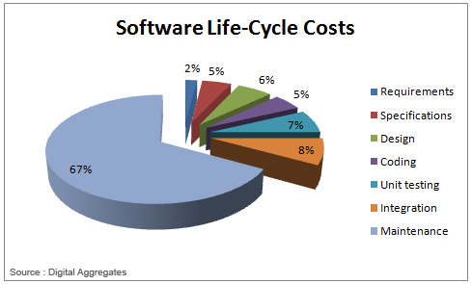
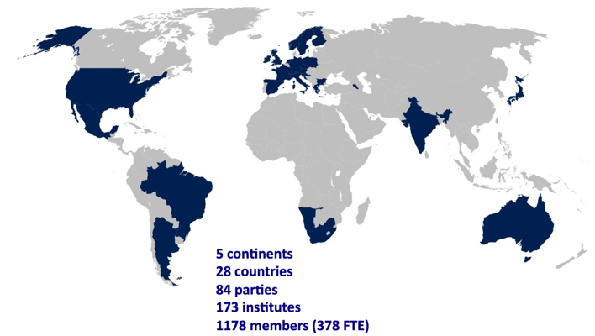
Design considerations
Minimise maintenance costs and maximise community involvement
CTA Consortium
Define and enforce coding rules (code quality)
Avoid dependencies (full control over product)
Support widely used platforms (Linux, Mac OS X, Solaris)
Automatize unit testing, integration and deployment (continuous integration system & quality check)
Open source development (end users develop the code)
Follow an Agile development model (implement what end users need)
Follow analysis models used in the high-energy astronomy domain (Fermi, INTEGRAL, XMM, Chandra, etc.)

Slide 5
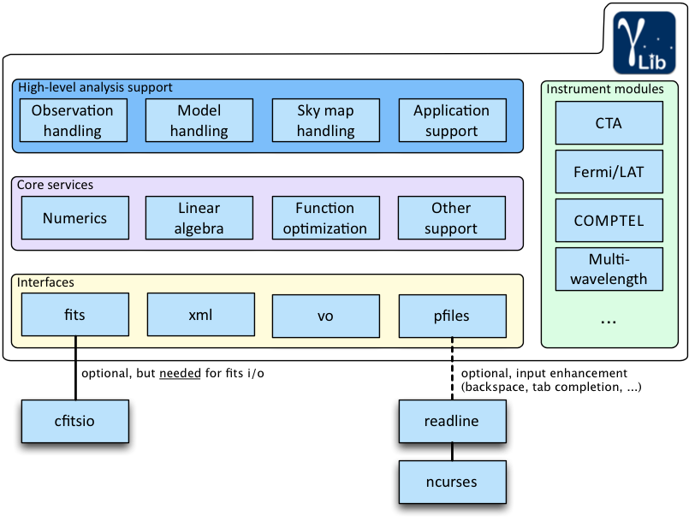
GammaLib overview
Abstract
Native
Compliant
Extendable
Notes:
Add some slides about what is supported by the instrument interfaces? Or at the end when it comes to status?

Slide 6
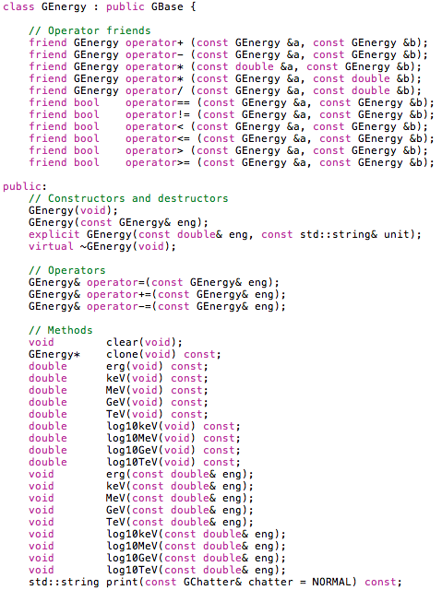
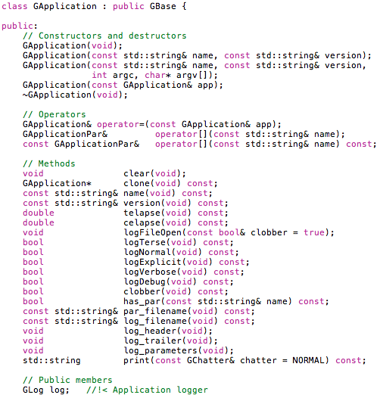
It’s all C++ classes

Slide 7
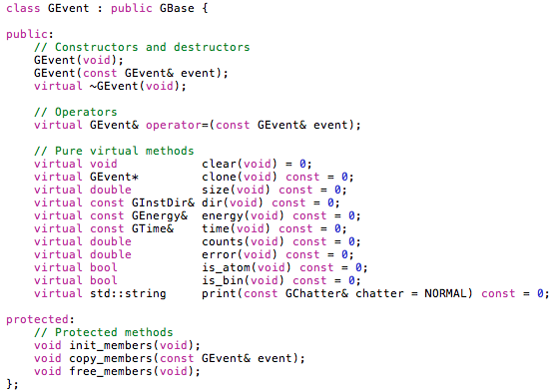
Abstract C++ classes for abstract interfaces

Slide 8
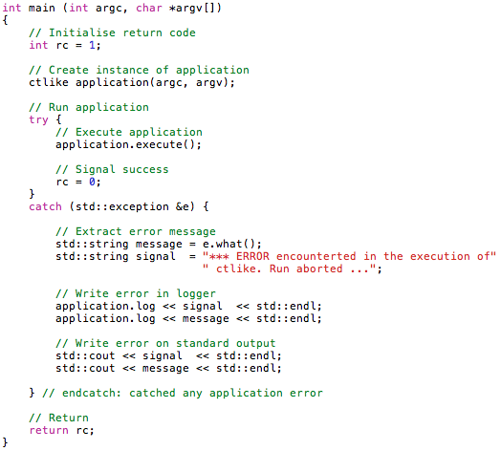
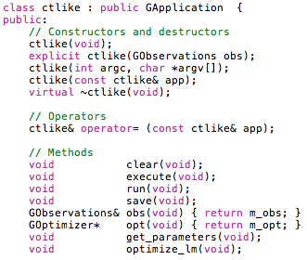
A ctool is an executable and a class
ctlike is a C++ class …
… that can be used as a Python class in a script …
… or as a C++ class in a C++ program (used to build the ctlike executable)

Slide 9
Running a ctool executable
CTA event list simulator
$ ctobssim
Model [$CTOOLS/share/models/crab.xml]
Calibration database [aar]
Instrument response function [DESY20140105_50h]
RA of pointing (degrees) (0-360) [83.63]
Dec of pointing (degrees) (-90-90) [22.01]
Radius of FOV (degrees) (0-180) [5.0]
Start time (MET in s) (0) [0.0]
End time (MET in s) (0) [1800.0]
Lower energy limit (TeV) (0) [0.1]
Upper energy limit (TeV) (0) [100.0]
Output event data file or observation definition file [events.fits]

Slide 10
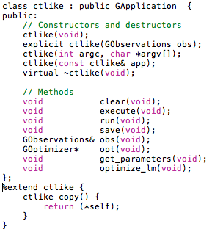
Wrapping C++ in Python: SWIG
http://www.swig.org/
ctlike.hpp
ctlike.i
$ swig -c++ -python -Wall ctlike.i
ctlike.py
ctlike_wrap.cpp
$ gcc ctlike_wrap.cpp

Slide 11
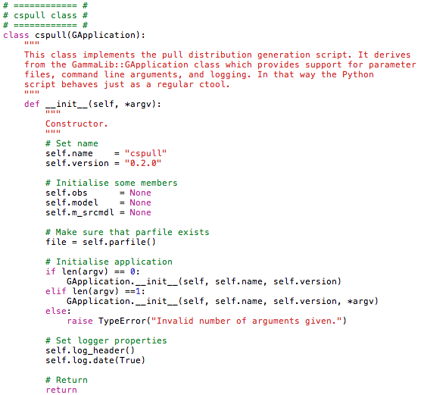
A cscript is a Python script looking like a ctool

Slide 12
The overall picture
Python
C++
cspull
cssens
cstsdist
cscaldb
lsmodel
ctobssim
ctbin
ctselect
ctlike
ctmodel
ctskymap
_ctools.so
ctools.py
libctools.so
swig
gammalib/
_app.so app.py
_base.so base.py
_com.so com.py
… …
swig
libgamma.so

Slide 13
What should I do if …
… I need a new spectral model?
Add a new spectral model class to the GammaLib model module.
… I need a new background model for CTA?
Add a new background model class to the GammaLib CTA interface module.
… I want a tool that generates CTA exposure maps?
Create a new ctool that uses the CTA response functions in GammaLib for exposure map computation.
… I want to implement an analysis workflow or pipeline?
Create a Python script that uses the ctools and gammalib Python modules.
… I want to test a new idea (e.g. create a ring background generator)?
Create a new cscript that uses the gammalib Python module.
General rule:
All generic and reusable code goes in GammaLib, code that is CTA specific and that is only needed for one specific task goes in ctools. Quick coding is better done by a cscript.

Slide 14
2. New features since last coding sprint New tools & scripts Stacked analysis

Slide 15
New tools
ctbutterfly
cttsmap
ctulimit
cterror
ctcubemask
ctbkgcube
ctpsfcube
ctexpcube
likelihood related
binned or stacked analysis
stacked analysis

Slide 16
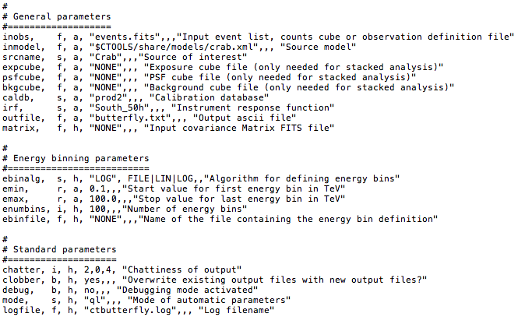
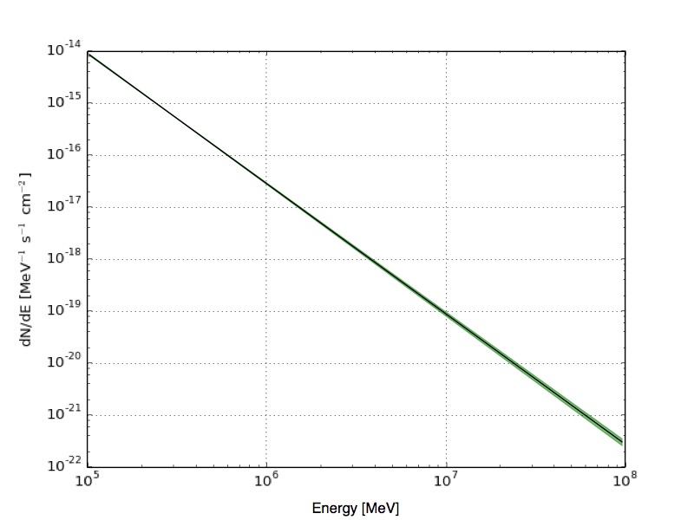
ctbutterfly
Purpose: produce a butterfly diagram for a spectral model M
flux error
spectral
model
gradient
covariance matrix
spectral
model
gradient
show_butterfly.py

Slide 17
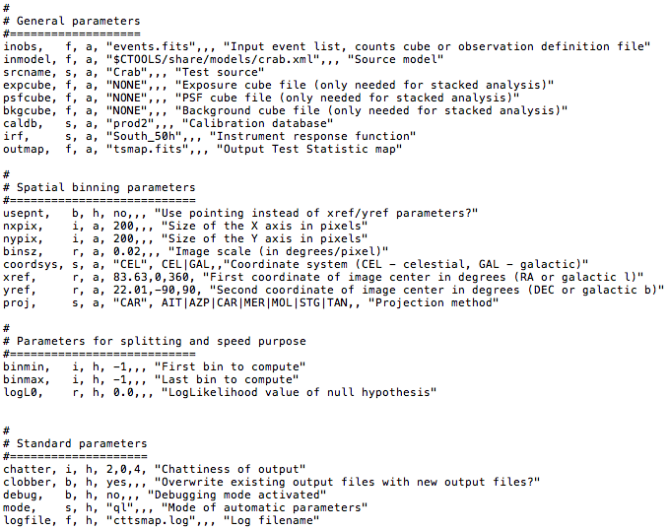
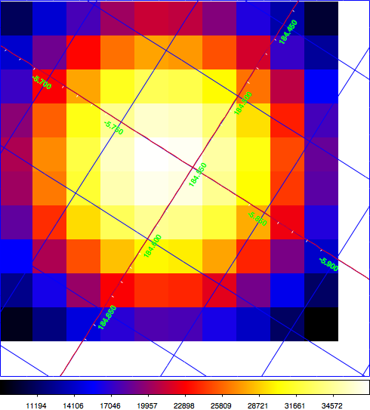
cttsmap
Purpose: produce a Test Statistics map
model with source located at α, δ
model
without source

Slide 18
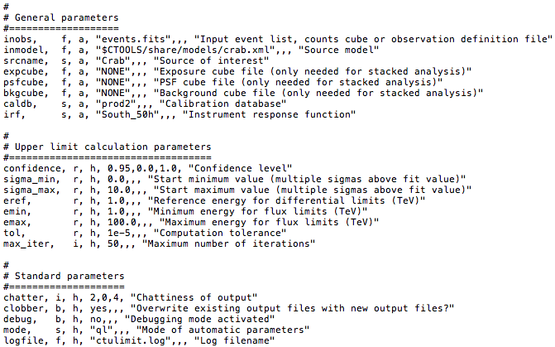
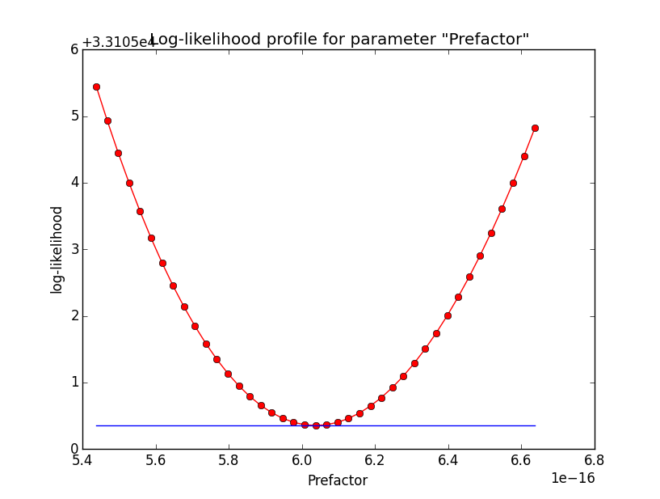
ctulimit
Purpose: produce upper flux limits for a source

Slide 19
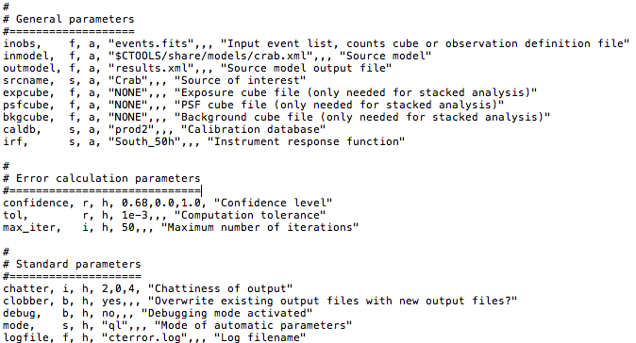
cterror
Purpose: evaluate errors using the likelihood profile

Slide 20
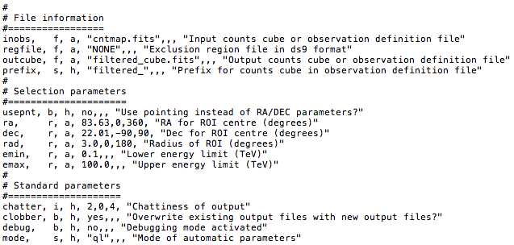
ctcubemask
Purpose: mask out bins in an events cube (by setting them to negative value)

Slide 21
Stacked analysis
Principle
Combine data for multiple observations (aka runs) into a single events cube.
Requires:
computation of an effective exposure (exposure cube)
computation of a (exposure) averaged point spread function (Psf cube)
computation of a (exposure) averaged background rate (Background cube)
As opposed to …
Unbinned analysis (events are not binned, observations are not combined, one IRF per observation)
Binned analysis (events are binned, observations are not combined, one IRF per observation)

Slide 22
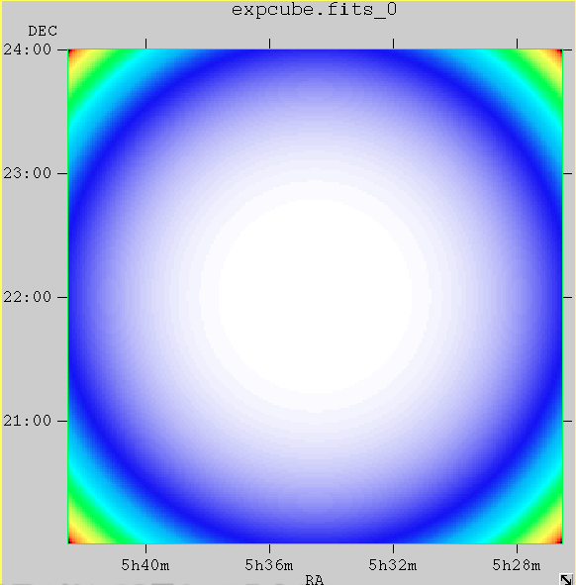
Stacked analysis
Implementation
ctbin* does now always combines multiple observations into a single event cube (before: ctbin generated one events cube per observation)
To get former behaviour requires an external loop over observations
ctexpcube* computes exposure
GCTACubeExposure
effective
area
livetime
*now only take into account bins within ROI

Slide 23
Stacked analysis
Implementation
ctpsfcube* computes average point spread function
GCTACubePsf
point spread function
effective
area
livetime
*now only take into account bins within ROI

Slide 24
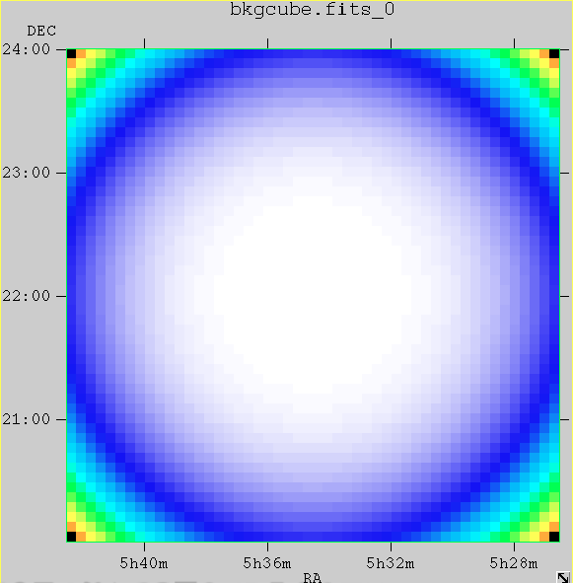
Stacked analysis
Implementation
ctbkgcube* computes average background rate
GCTACubeBackground
background
rate
livetime
*now only take into account bins within ROI

Slide 25
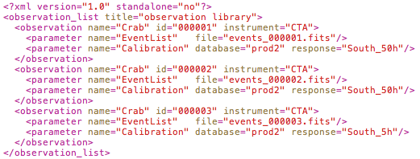
Stacked analysis
Analysis steps
1. Define your list of observations in an XML file
2. Run ctselect on this list to define the ROIs
use pointing as ROI centre
select events within 3° around pointing

Slide 26
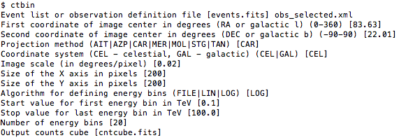
Stacked analysis
Analysis steps
use selected events
3. Run ctbin
now generates a single counts cube
needs definition of observations
4. Run ctexpcube
take exposure cube definition from counts cube

Slide 27
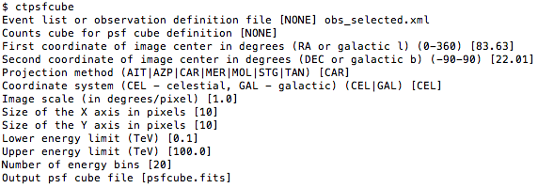
Stacked analysis
Analysis steps
needs definition of observations
5. Run ctpsfcube
don’t take PSF cube
definition from counts cube
6. Run ctkbgcube
generates updated model

Slide 28
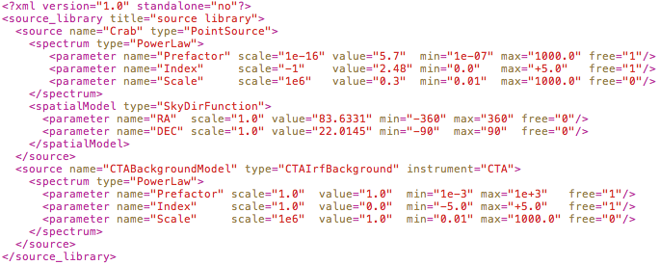
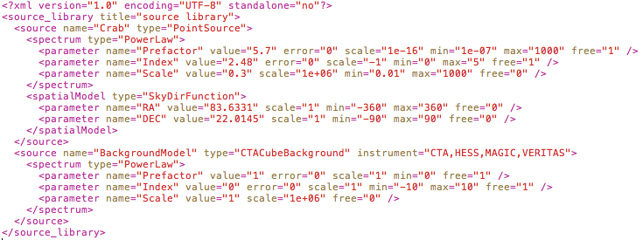
Stacked analysis
Analysis steps
input
model
after
ctbkgcube

Slide 29
Stacked analysis
Analysis steps
7. Run ctlike
provide outputs from
ctbin, ctexpcube, ctpsfcube and ctbkgcube

Slide 30
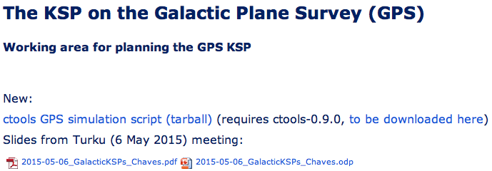
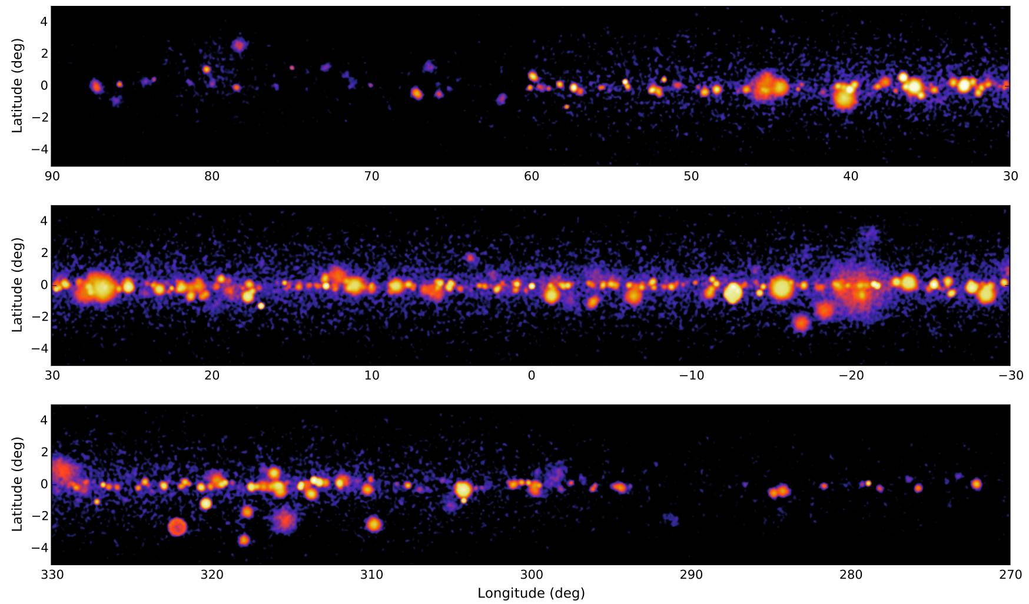
Stacked analysis
https://portal.cta-observatory.org/WG/PHYS/SitePages/PHYS-KSP-GPS.aspx

Slide 31
New scripts
csresmap
csspec
cslightcrv
csobsdef
fit quality
likelihood related
observation definition

Slide 32
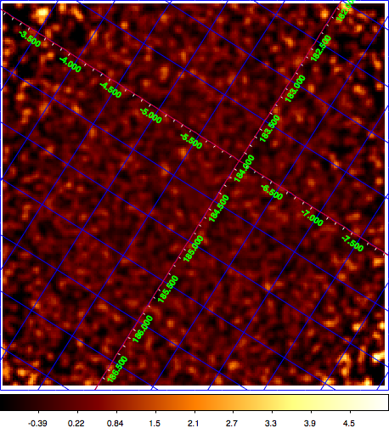
csresmap
Purpose: produce a residual counts map*
counts
model
residual
map
*does not yet work for stacked analysis

Slide 33
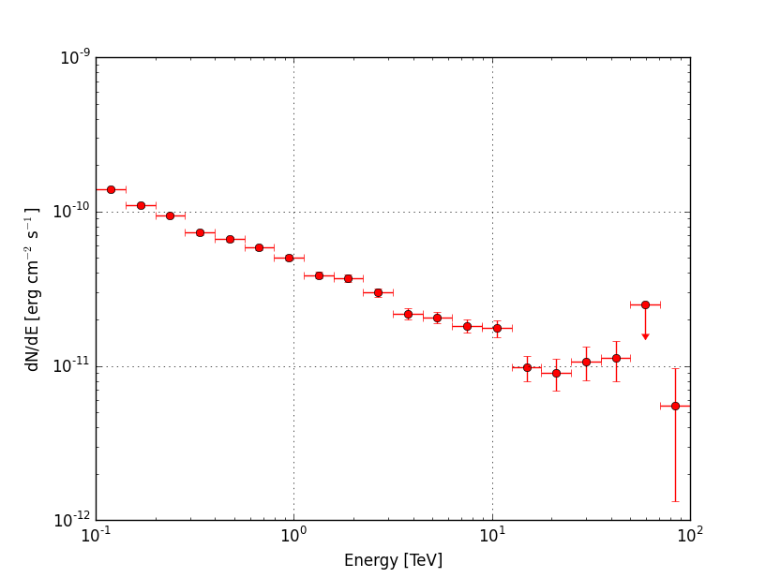
csspec
Purpose: runs ctlike in various energy bands to produce a spectrum (including upper limits)
show_spectrum.py

Slide 34
cslightcrv
Purpose: runs ctlike in various temporal bands to produce a light curve (including upper limits)
no plotting script yet (maybe something to do at the sprint)

Slide 35
csobsdef
Purpose: generation of an observation definition XML file
see script
make_pointings.py
for survey KSPs
defines ROI radius
Output can be directly fed into ctobssim …

Slide 36
3. Instrument Response Functions

Slide 37
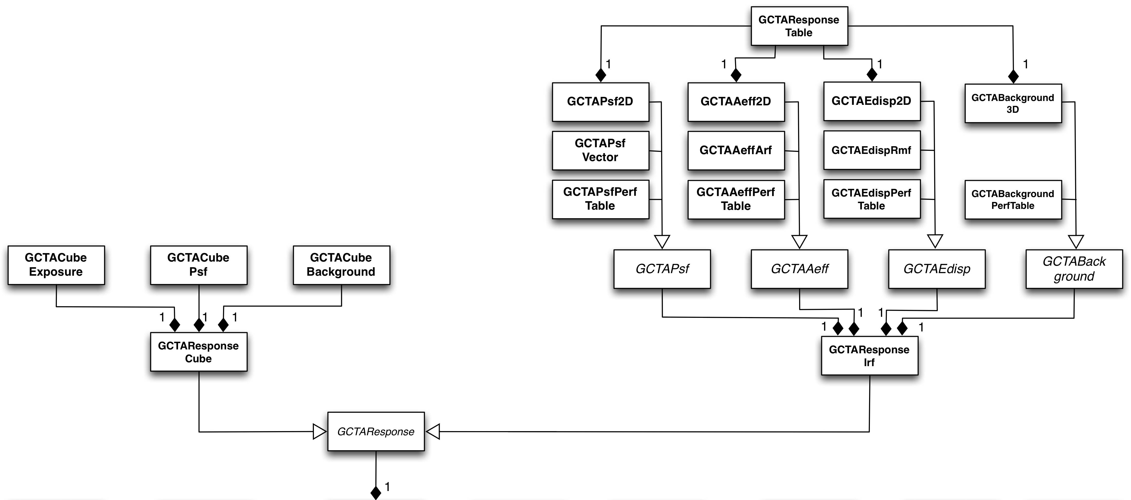
Current IRF handling
effective area (cm2)
point spread function
energy
dispersion
Full area, no angle cuts
Response tables
XSPEC-like (1DC)
Performance tables
stacked response

Slide 38
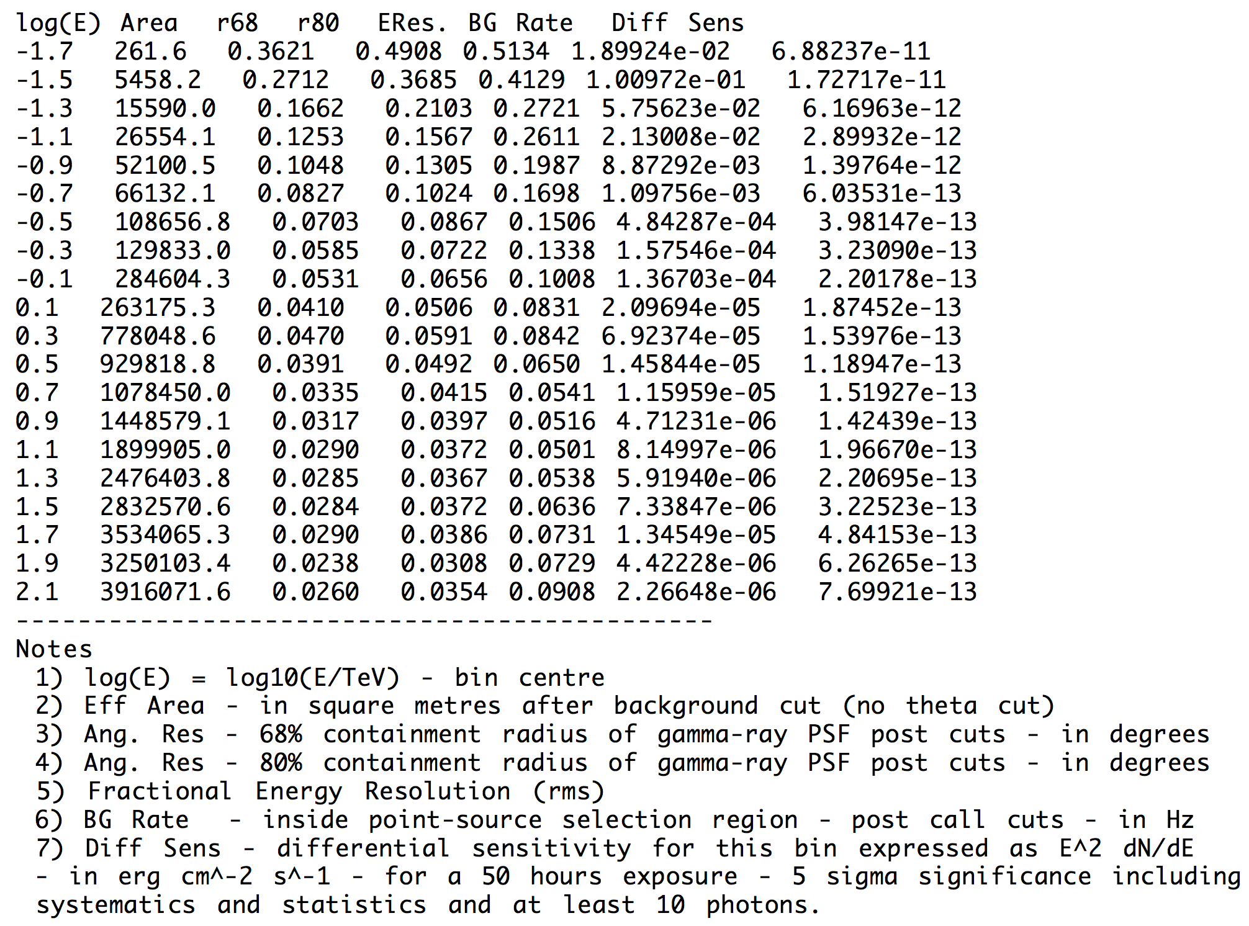
Performance tables
GCTAAeffPerfTable
GCTAPsfPerfTable
GCTAEdispPerfTable
GCTABackgroundPerfTable
Only on-axis information
A_{eff} and B_{rate} off-axis dependence modelled using
Gaussians assumed for PSF and energy dispersion

Slide 39
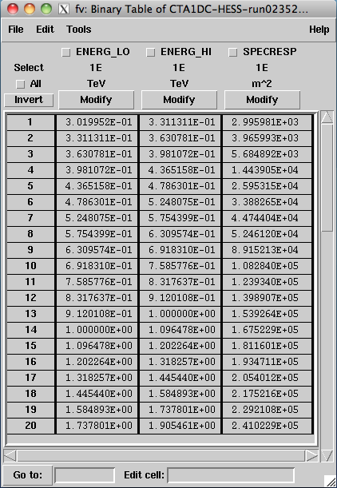
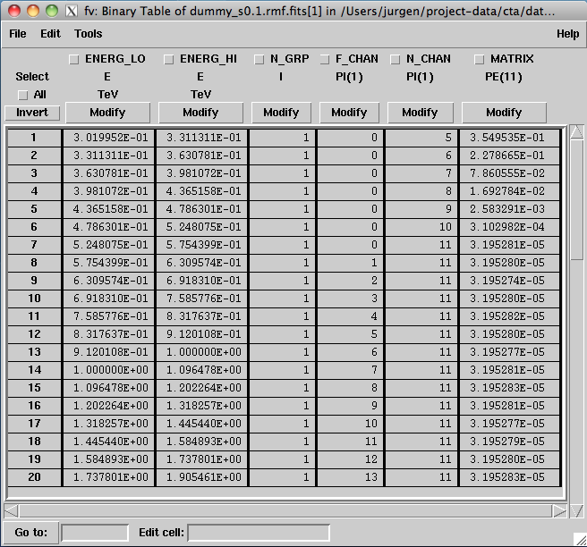
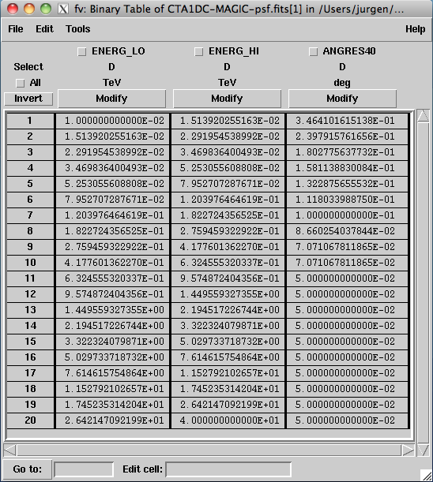
ARF, RMF, PSF vectors
GCTAAeffArf
GCTAPsfVector
GCTAEdispRmf
Only on-axis information
A_{eff} off-axis dependence modelled using
Gaussian assumed for PSF

Slide 40
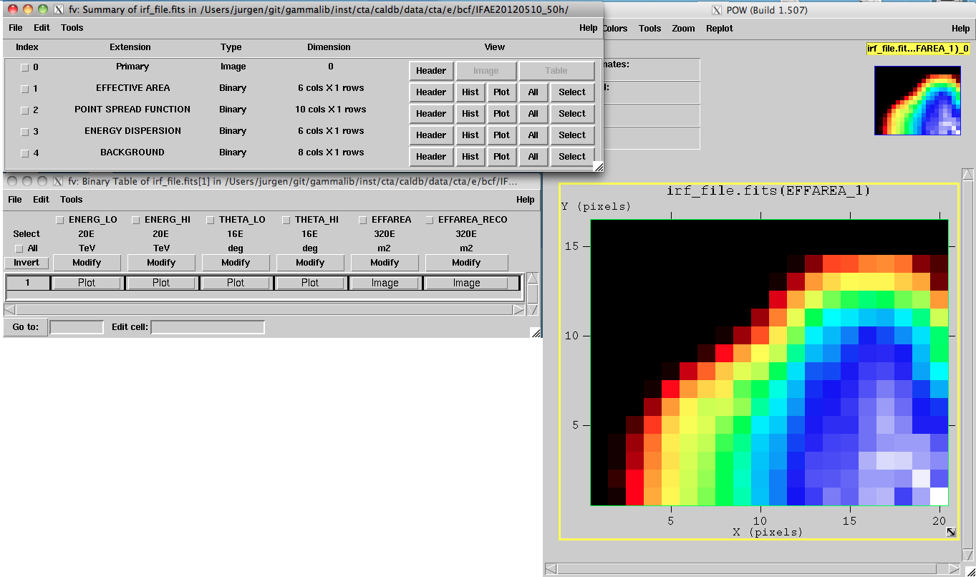
Response tables
GCTAAeff2D
GCTAPsf2D
GCTAEdisp2D
GCTABackground3D
One extension per response component
All response component in single file
Future: all response components in event file

Slide 41
Response tables
axis 1 bins [LO, HI]
axis 2 bins [LO, HI]
data 1
data 2
Format of Fermi/LAT instrument response files
Can handle n-dimensional cubes (don’t need to be contiguous)
Can handle arbitrary number of data blocks
Can handle parametric models (each data block is a parameter)
Handling of this format implement by class GCTAResponseTable

Slide 42
Response tables
Effective area
Function of energy and off axis angle
Store A_{eff} values as function or true or measured energy
Point spread function
Function of energy and off axis angle
Two parametric variants: 3-Gaussians (6 parameters), King function (2 parameters)

Slide 43
Response tables
Effective area
Function of energy and off axis angle
Store A_{eff} values as function or true or measured energy
Point spread function
Function of energy and off axis angle
Two parametric variants: 3-Gaussians (6 parameters), King function (2 parameters)

Slide 44
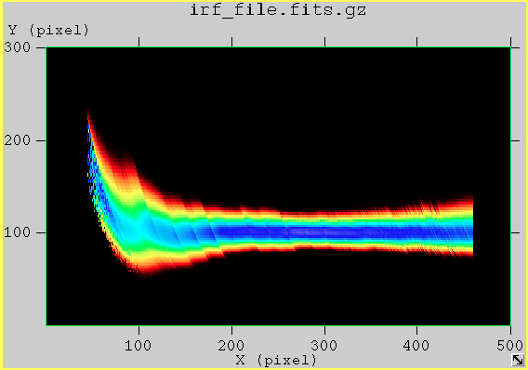
Response tables
Energy dispersion
Function of true energy, E_{reco}/E_{true} and off axis angle
Store migration matrix (3D)

Slide 45
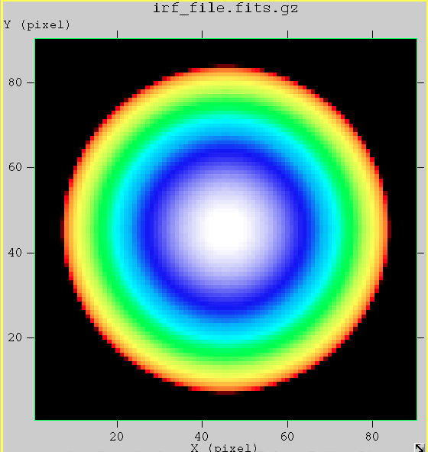
Response tables
Background rates
Function of DETX, DETY and measured energy
Store rates per energy and solid angle (3D)

Slide 46
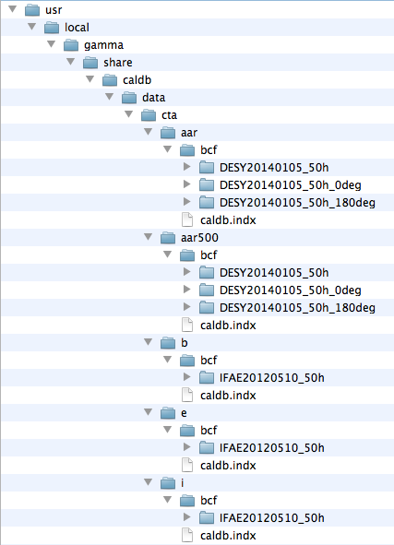
Calibration database usage
Set calibration database root:
export CALDB=/usr/local/gamma/share/caldb
mission
instrument
rspname
Specifying response as input parameters:
$ ctobssim
Model [$CTOOLS/share/models/crab.xml]
Calibration database [aar]
Instrument response function [DESY20140105_50h]
RA of pointing (degrees) (0-360) [83.63]
Dec of pointing (degrees) (-90-90) [22.01]
Radius of FOV (degrees) (0-180) [5.0]
Start time (MET in s) (0) [0.0]
End time (MET in s) (0) [1800.0]
Lower energy limit (TeV) (0) [0.1]
Upper energy limit (TeV) (0) [100.0]
Output event data file or observation definition file [events.fits]

Slide 47
Calibration database usage
Set calibration database root:
export CALDB=/usr/local/gamma/share/caldb
mission
instrument
rspname
Specifying response in XML observation definition file:
<observation_list title="observation library">
<observation name="Crab" id="00001" instrument="CTA">
<parameter name="EventList" file="events.fits"/>
<parameter name="Calibration" database="aar" response="DESY20140105_50h"/>
</observation>
</observation_list>

Slide 48
Calibration database usage
Set calibration database root:
export CALDB=/usr/local/gamma/share/caldb
mission
instrument
rspname
Specifying response within Python script:
import gammalib
obs = gammalib.GCTAObservation()
caldb = gammalib.GCaldb("cta", "aar")
irf = "DESY20140105_50h"
obs.response(irf, caldb)

Slide 49
Evolutions
Ultimately we would like to have a CTA events file that looks like this (event selection and instrument response functions are tied together; it makes sense to store them together).
Auxiliary information could be added (for example pointing or weather information)
For each observation (aka run) the user would get a single, self contained file. This considerably simplifies data distribution and data handling and minimizes the danger of improper usage.
This would make the usage of a calibration database obsolete.

Slide 50
4. Goals of this sprint

Slide 51
Goals of this sprint

Slide 52
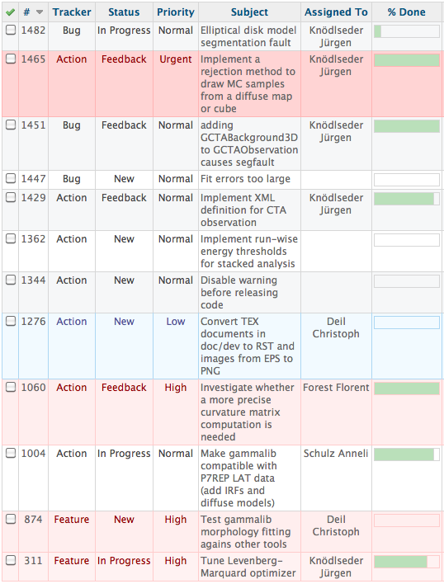
Roadmap towards gammalib release 1.0

Slide 53
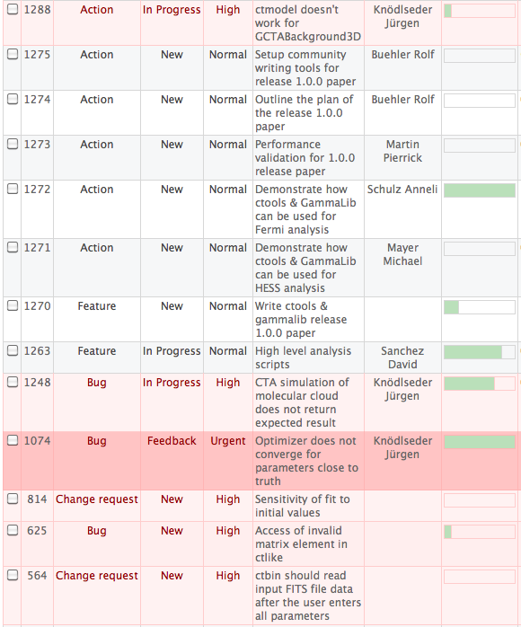
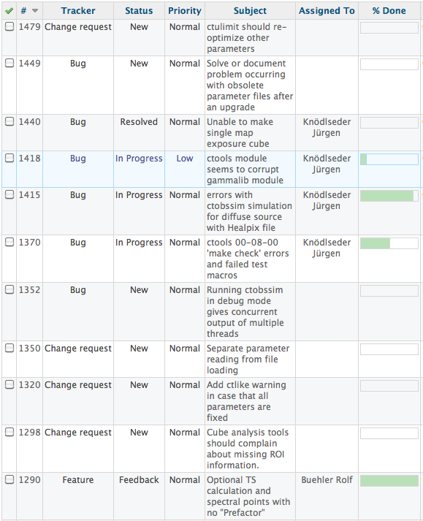
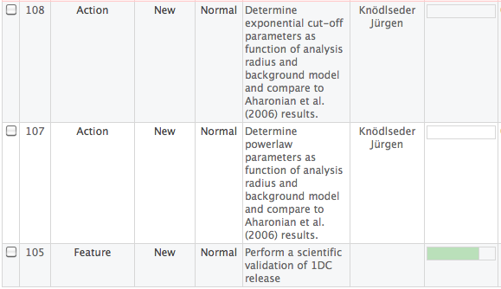
Roadmap towards ctools release 1.0

Slide 54
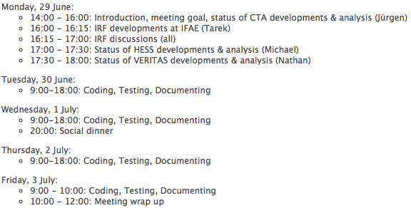
Agenda

