Slide 1


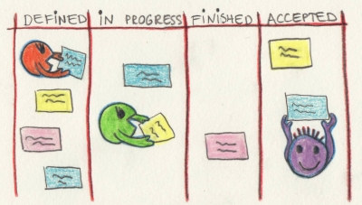
3nd Coding Sprint
GammaLib and ctools concepts
Coding for GammaLib and ctools
Current status
Goals of this sprint
Jürgen Knödlseder (IRAP)

Slide 2
1. GammaLib and ctools concepts

Slide 3
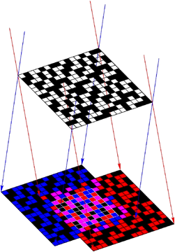
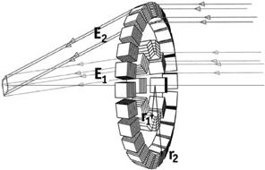
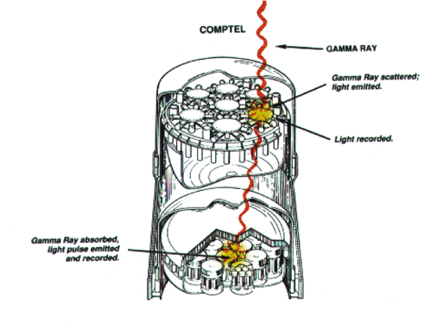
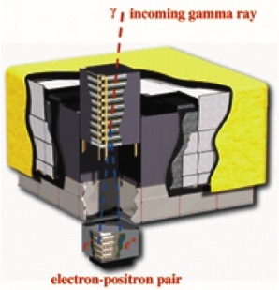
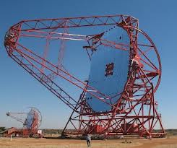


Concept
MeV
keV
GeV
TeV
All gamma-ray telescopes measure individual photons as events. In principle it should be possible to handle events from gamma-ray telescopes in an abstract and common software framework.
Existing high-energy analysis frameworks share a number of common features (FITS files, likelihood fitting, modular design).
… is the client that uses the bricks provided by
CTA specific
generic
… to build a set of analysis executables for CTA (and alike)

Slide 4
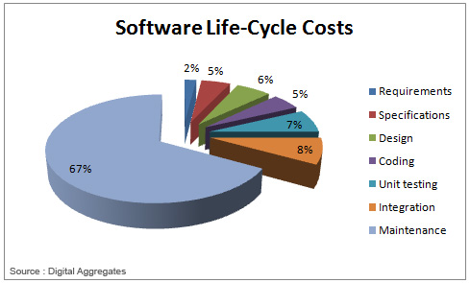
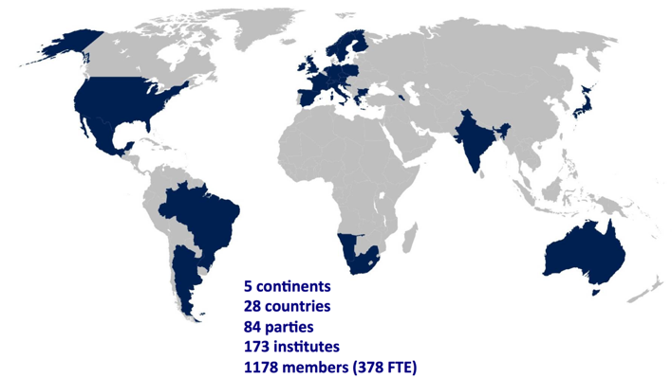
Design considerations
Minimise maintenance costs and maximise community involvement
CTA Consortium
Define and enforce coding rules (code quality)
Avoid dependencies (full control over product)
Support widely used platforms (Linux, Mac OS X, Solaris)
Automatize unit testing, integration and deployment (continuous integration system & quality check)
Open source development (end users develop the code)
Follow an AGILE development model (implement what end users need)
Follow analysis models used in the high-energy astronomy domain (Fermi, INTEGRAL, XMM, Chandra, etc.)

Slide 5
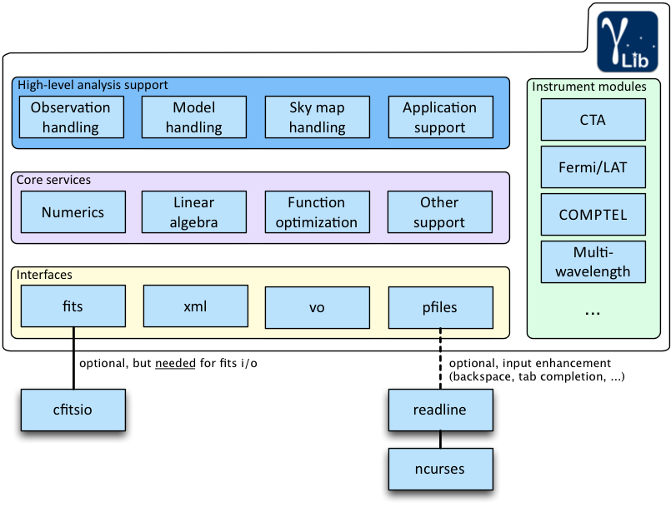
GammaLib overview
Abstract
Native
Compliant
Extendable
Notes:
Add some slides about what is supported by the instrument interfaces? Or at the end when it comes to status?

Slide 6
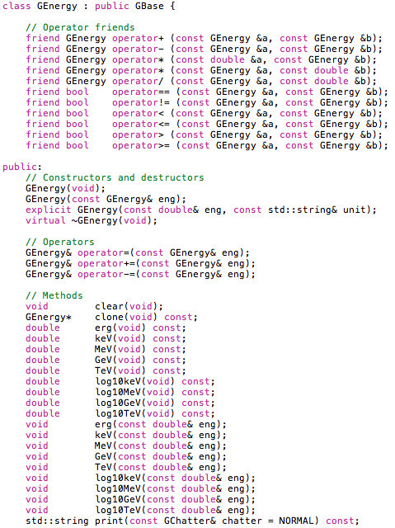
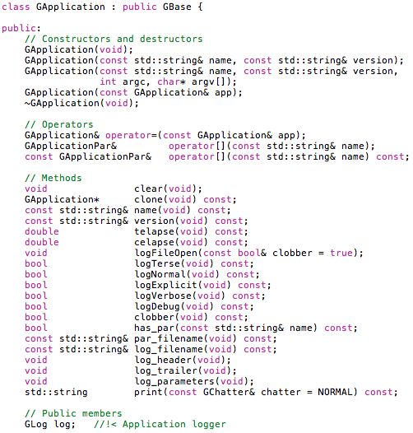
It’s all C++ classes

Slide 7
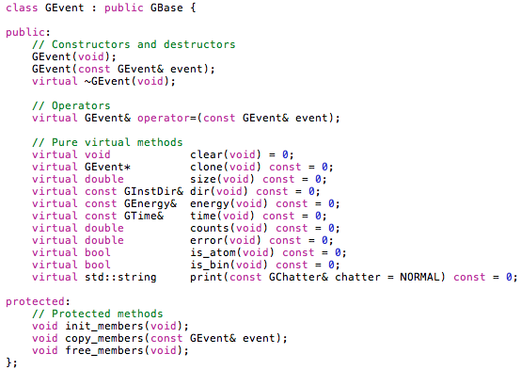
Abstract C++ classes for abstract interfaces

Slide 8
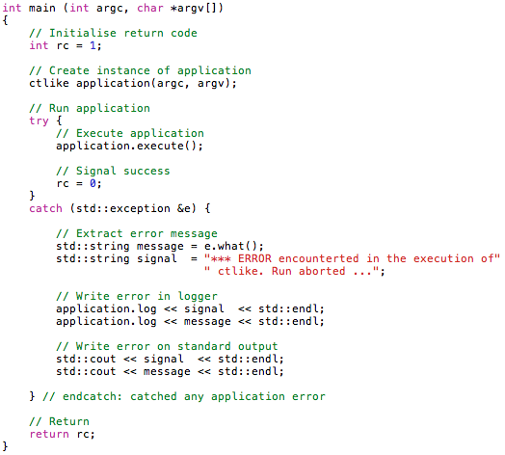
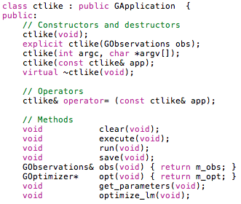
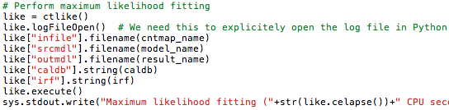
A ctool is an executable and a class
ctlike is a C++ class …
… that can be used as a Python class in a script …
… or as a C++ class in a C++ program
(used to build the ctlike
executable)

Slide 9
Running a ctool executable
CTA event list simulator
$ ctobssim
Model [$CTOOLS/share/models/crab.xml]
Calibration database [aar]
Instrument response function [DESY20140105_50h]
RA of pointing (degrees) (0-360) [83.63]
Dec of pointing (degrees) (-90-90) [22.01]
Radius of FOV (degrees) (0-180) [5.0]
Start time (MET in s) (0) [0.0]
End time (MET in s) (0) [1800.0]
Lower energy limit (TeV) (0) [0.1]
Upper energy limit (TeV) (0) [100.0]
Output event data file or observation definition file [events.fits]

Slide 10
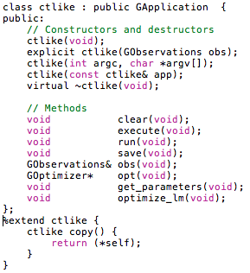
Wrapping C++ in Python: SWIG
http://www.swig.org/
ctlike.hpp
ctlike.i
$ swig -c++ -python -Wall ctlike.i
ctlike.py
ctlike_wrap.cpp
$ gcc ctlike_wrap.cpp

Slide 11
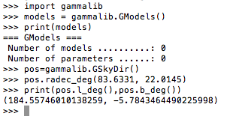
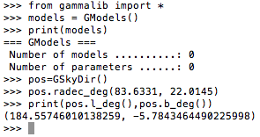
Using GammaLib in Python
… same story for ctools

Slide 12
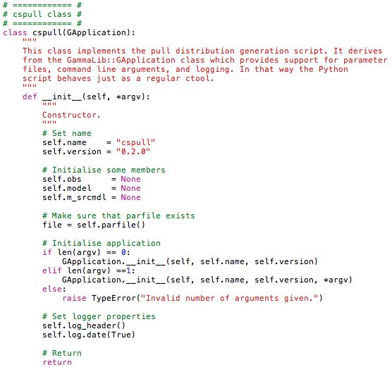
A cscript is a Python script looking like a ctool

Slide 13


The overall picture
Python
C++
cspull
cssens
cstsdist
cscaldb
lsmodel
ctobssim
ctbin
ctselect
ctlike
ctmodel
ctskymap
_ctools.so
ctools.py
libctools.so
swig
gammalib/
_app.so app.py
_base.so base.py
_com.so com.py
… …
swig
libgamma.so

Slide 14
What should I do if …
… I need a new spectral model?
Add a new spectral model class to the GammaLib model module.
… I need a new background model for CTA?
Add a new background model class to the GammaLib CTA interface module.
… I want a tool that generates CTA exposure maps?
Create a new ctool that uses the CTA response functions in GammaLib for exposure map computation.
… I want to implement an analysis workflow or pipeline?
Create a Python script that uses the ctools and gammalib Python modules.
… I want to test a new idea (e.g. create a ring background generator)?
Create a new cscript that uses the gammalib Python module.
General rule:
All generic and reusable code goes in GammaLib, code that is only needed for one specific task goes in ctools. Quick coding is better done by a cscript.

Slide 15
2. Coding for GammaLib and ctools

Slide 16

Communities
Users
Use official releases
Code and documentation at
http://gammalib.sourceforge.net/
http://cta.irap.omp.eu/ctools/index.html
@gammalib
Developers
Managers
Use git trunk (devel)
Forge including developer documentation at
https://cta-redmine.irap.omp.eu/projects/gammalib
https://cta-redmine.irap.omp.eu/projects/ctools
Use git
Forge, Jenkins, Sonar
Unit tests (make check)
Documentation as for developers

Slide 17

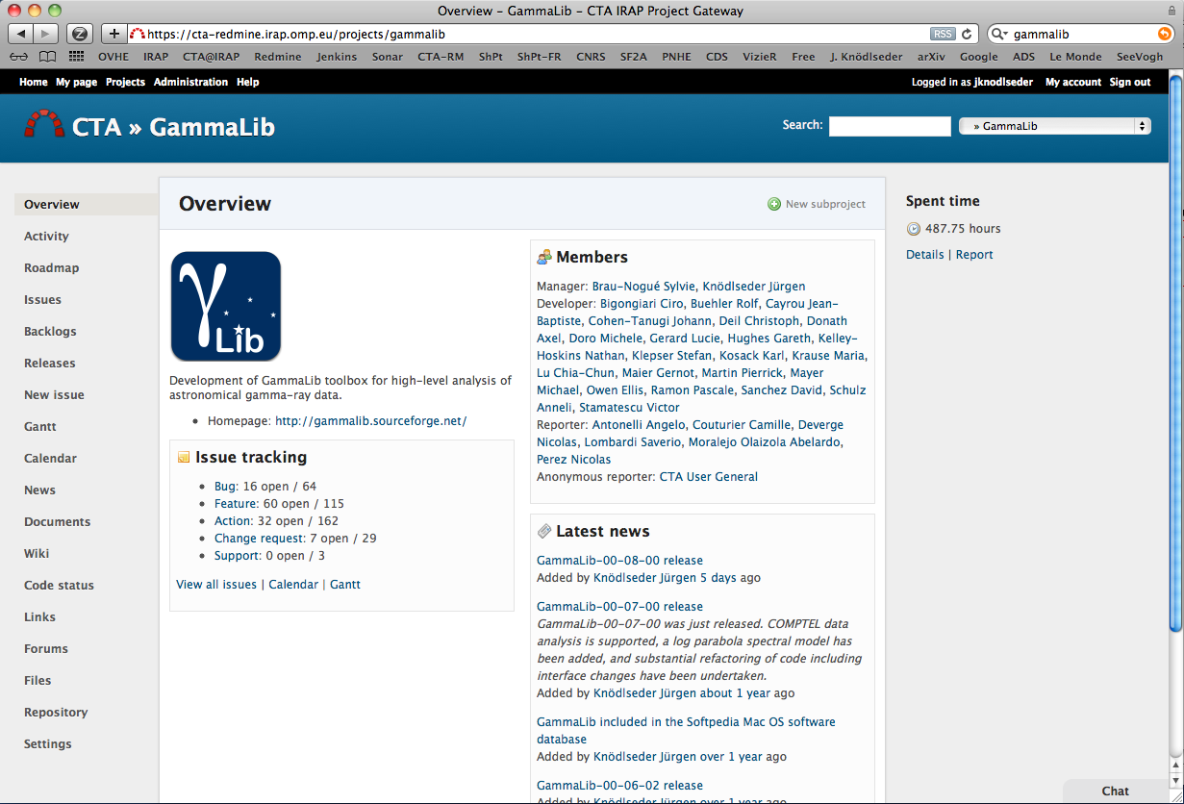
Our Forge
If you want a new feature, find a bug, or request a change: use it!
Don’t worry too much whether you file things under ctools or GammaLib
(will clean up if needed)

Slide 18

Repository organization
The GammaLib and ctools source code are version controlled in two git repositories at IRAP
https://cta-git.irap.omp.eu/gammalib
https://cta-git.irap.omp.eu/ctools
Protected branches:
master – last release
release – release preparation
devel – developer branch <== always start from here
integration – feature integration
Other branches: can be setup by any developer as required. Will be regularly cleaned-up after pulling in changes.
Gammalib and ctools development can also be based on Github:
https://github.com/gammalib/gammalib
https://github.com/ctools/ctools
read-only repositories
synchronized with IRAP repositories

Slide 19
Some frequently asked questions
Should I use IRAP git or github for development?
Whatever you prefer. Both repositories should be 100% synchronized at any time.
Which branch should I start from?
Always branch from devel. Never branch from master.
How often should I commit?
Whenever you feel necessary. Note that the more often you commit the better all changes are tracked and the easier it is to go back to a certain stage of your code development. However, before committing, please check that the code at least compiles (best make also a unit test).
Why can’t I push to master, release, devel or integration?
These branches are protected from pushing. Only the integration manager is allowed to push to them. See it from the good side: this puts a lower work burden on your side, and prevents you from destroying the repository.

Slide 20


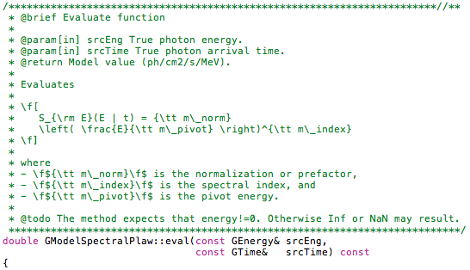
Documentation
Code documentation
User documentation
Extracts code documentation directly from
source files. Latest version of devel branch
online at
http://gammalib.sourceforge.net/doxygen/
http://cta.irap.omp.eu/ctools/doxygen/
Generates documents from reStructuredText
files (markup language). Latest version of
devel branch online at
http://gammalib.sourceforge.net/
http://cta.irap.omp.eu/ctools/

Slide 21
Code organisation
https://cta-git.irap.omp.eu/gammalib
https://cta-git.irap.omp.eu/ctools
gammalib/
dev Developer material
doc Code and user documentation
examples Example code
include Core* header files (.hpp)
inst Instrument modules
m4 Code configuration macros
pyext Core* Python extension files (.i)
src Core* source files (.cpp)
test Code for unit testing
*Core means instrument independent code
ctools/
caldb Calibration data
doc Code and user documentation
examples Example code
m4 Code configuration macros
models Source and background models
pyext Python extension files (.i)
scripts cscripts and Python scripts
src ctools
test Code for unit testing

Slide 22
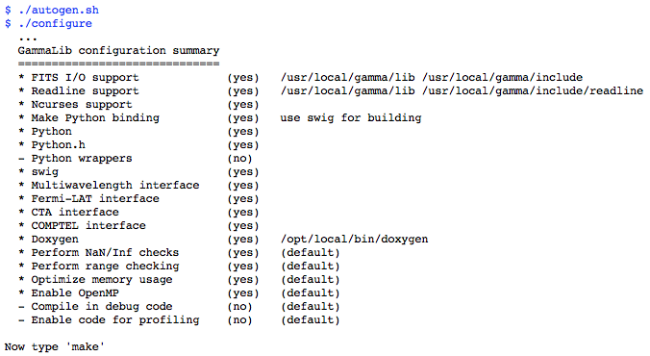
Configuring GammaLib
https://cta-redmine.irap.omp.eu/projects/gammalib/wiki/Contributing_to_GammaLib
generates configure script from configure.ac
configures GammaLib for your system

Slide 23
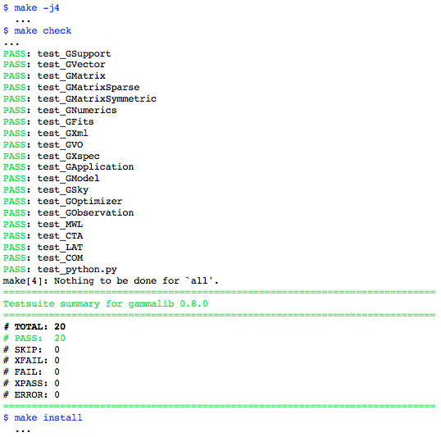
Building, checking, installing
https://cta-redmine.irap.omp.eu/projects/gammalib/wiki/Contributing_to_GammaLib
compiles code (using 4 cores at maximum)
compiles and executes unit test code
Note: if you switch branches you may need to issue
$ make clean
$ make –j4
for a full recompliation of the library. Also, if some symbols are missing when doing a unit check, make a full recompilation (and get some coffee).
installs code (copy of build result)

Slide 24
Why coding conventions?
From the Java Programming Language, Sun Microsystems:
Code conventions are important to programmers for a number of reasons:
40%-80% of the lifetime cost of a piece of software goes to maintenance.
Hardly any software is maintained for its whole life by the original author.
Code conventions improve the readability of the software, allowing engineers to understand new code more quickly and thoroughly.
If you ship your source code as a product, you need to make sure it is as well packaged and clean as any other product you create.
Is there a unique and best C++ style?
Coding style can affect performance and even code correctness, but there are also rules that mainly affect readability (indentation, placement of brackets, etc.), hence coding style is also a matter of taste (you can certainly argue endless nights about the best coding style).
Take home message:
GammaLib and ctools are both developed following coding conventions. Please follow them as good as you can as they may prevent errors, can lead to better code, and will help newcomers to understand the code base.

Slide 25
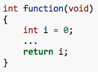



General coding rules
(apply to GammaLib and ctools; will be enforced)
Code format
Blocks are indented by 4 characters
No tabs, use spaces
Try to not exceed 80 characters per line
Separate by spaces, e.g.
Use C++98 standard
Do not use C++11 features
Curly opening bracket at end
Function format
Block format
Curly opening bracket
at new line
Always use brackets if a block
splits over more than a single
line
Code alignment

Slide 26
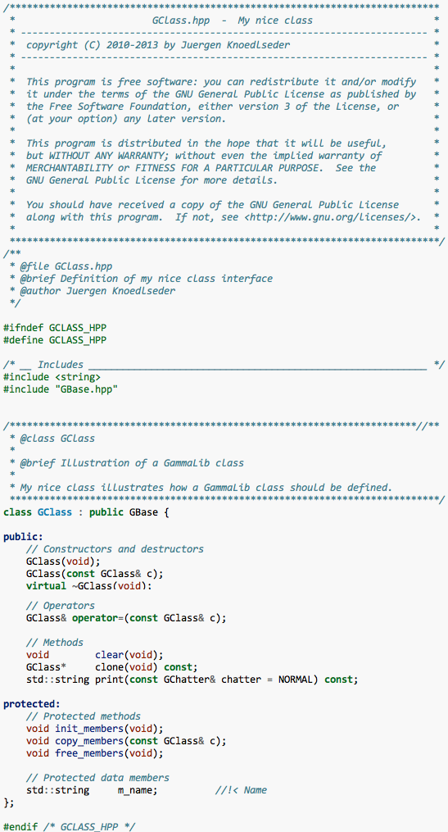
C++ classes (.hpp file) - definition
File name and short class description
Dates from creation to last editing;
Person who created the file initially
Copyright (GPL 3)
File name, brief description, person who created
file (Doxygen syntax)
Includes (C, C++ using < >; GammaLib using “ “)
Class description (Doxygen syntax)
Protection
Public
Constructors
Operators
Methods
Protected or private
Methods
Members

Slide 27
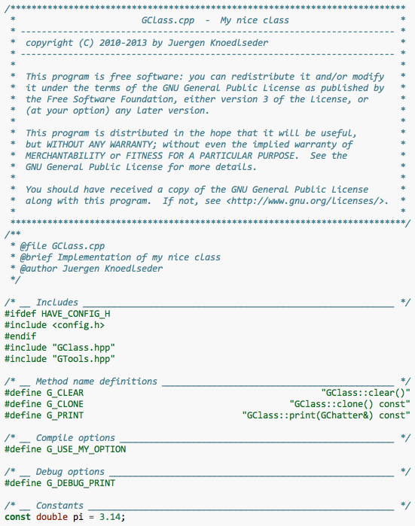
C++ classes (.cpp file) - implementation
Header equivalent to .hpp file
Makes compile configuration available
to the source code file.
Method names used in exceptions
Compile options
Compile options for debugging
Global constants

Slide 28
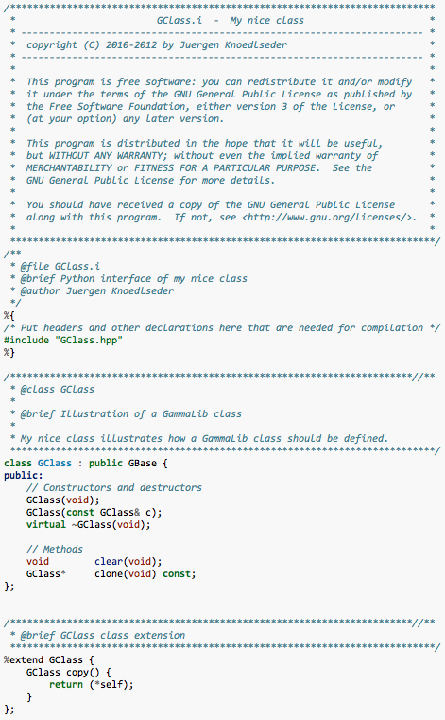
Python classes (.i file) - extension
Header equivalent to .hpp file
SWIG directive to include corresponding .hpp file
(and whatever else is needed for compilation)
Basically a copy of the public class definition from
the .hpp file
without:
operators
print() method
const versions of methods
Extensions to the class only available in Python

Slide 29
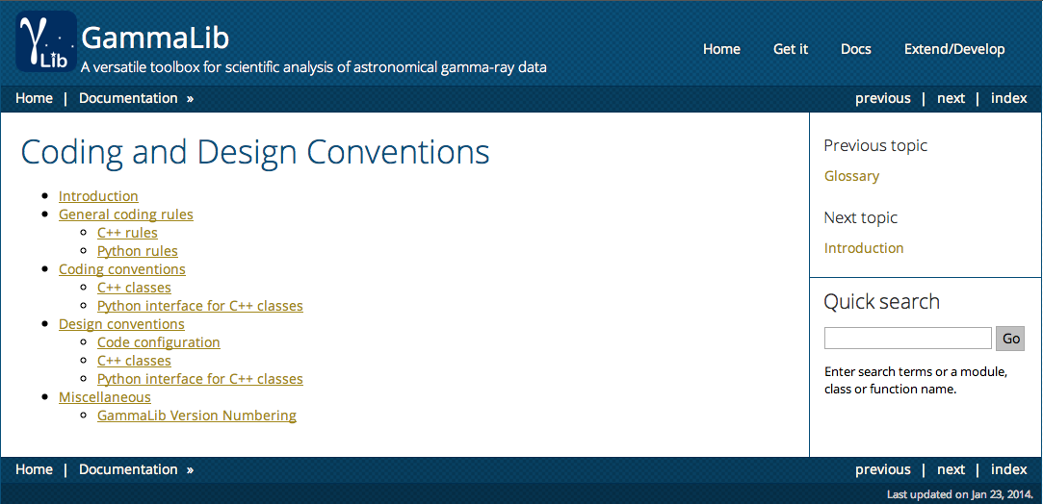
More reading
http://gammalib.sourceforge.net/coding/

Slide 30
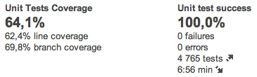
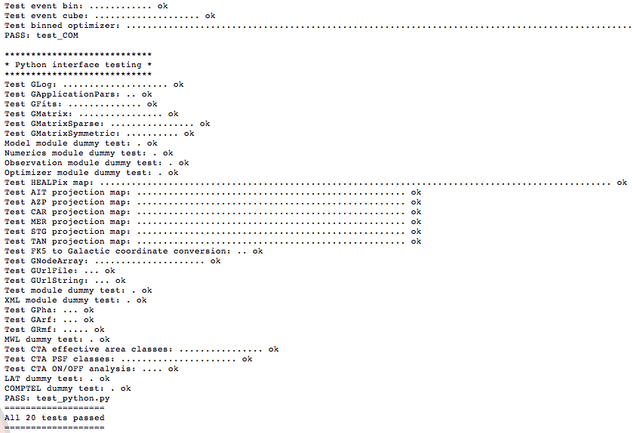
Unit testing
Code testing is an integrated feature of gammalib (and ctools), but not all code is yet covered …
make check
Each dot is an individual test case:
. = okay
F = failure (unexpected result)
E = error (unexpected behaviour, e.g. seg. fault)
Note: for automake >= 1.13, console
dumps end up in test/test_*.log

Slide 31
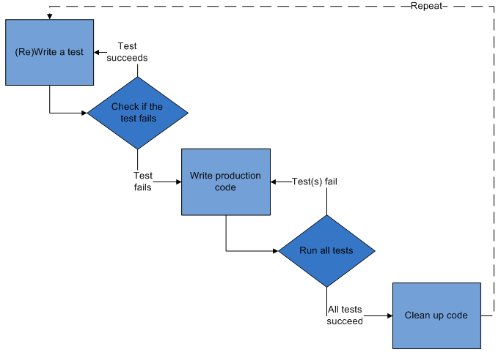
Test driven development
You should give it a try …

Slide 32
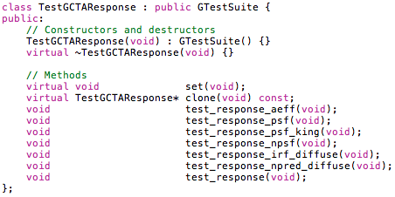
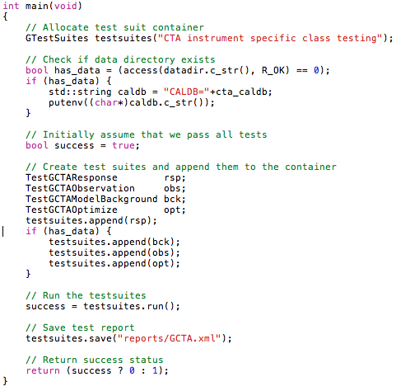
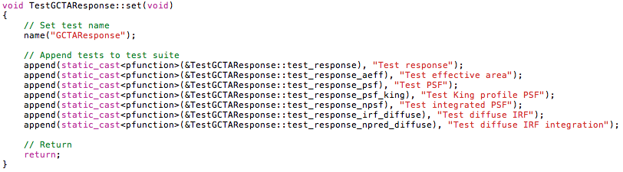
How to write a new C++ unit test? As C++ class!
(see inst/test/test_CTA.hpp and inst/test/test_CTA.cpp)
Create a class that derived from GTestSuite
Append GTestSuite to container, run
tests and save results
Implement set method

Slide 33
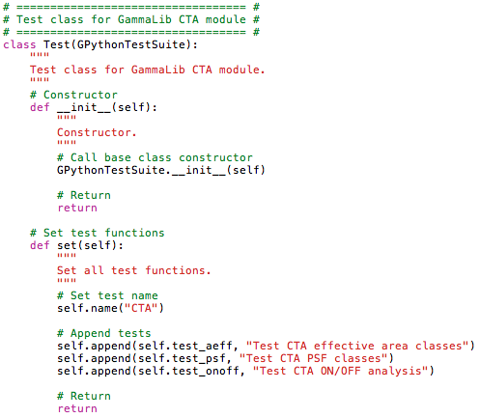
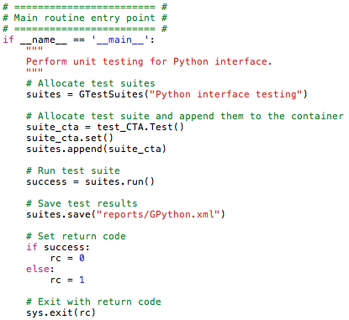
And in Python?
Allocate test class, append to container,
run tests and save results
Create class derived from GPythonTestSuite

Slide 34
3. Current status

Slide 35
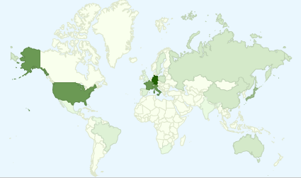
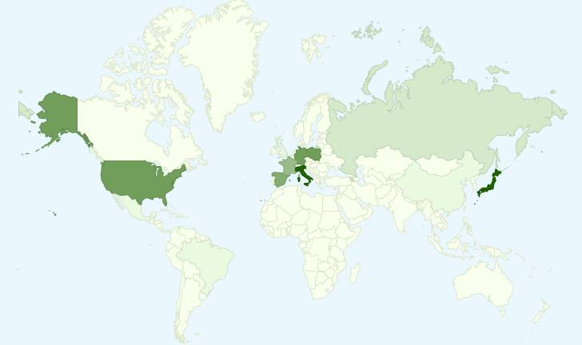
GammaLib world map
SourceForge downloads
2013
2014
Notes:
2013: 132
2014: 64 (up to 3/7/14)

Slide 36
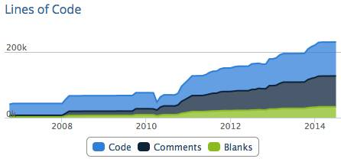
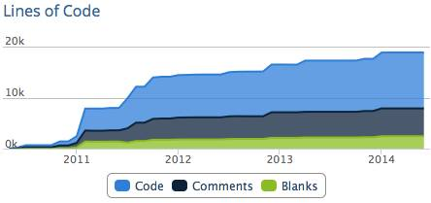
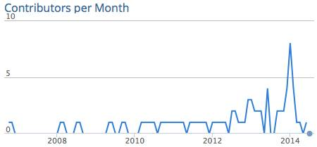
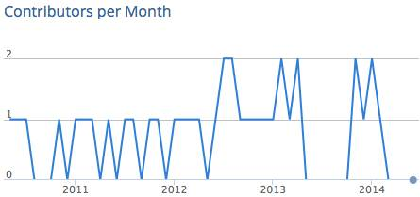
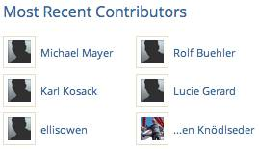
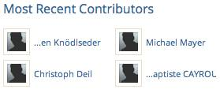

GammaLib & ctools statistics
https://www.ohloh.net/
for your picture!

Slide 37
Current status
GammaLib
ctools
Release 00-08-01
Includes abstract observation handling, data modelling, model fitting, application support
Provides FITS and XML interfaces
Homogeneous class interfaces
Support for
- CTA (binned and unbinned)
- Fermi/LAT (binned)
- COMPTEL (binned)
- Multi-wavelength
Release 00-07-01
Provides observation simulation, event selection, binning, model fitting, sky mapping
Supports multi-instrument fitting

Slide 38


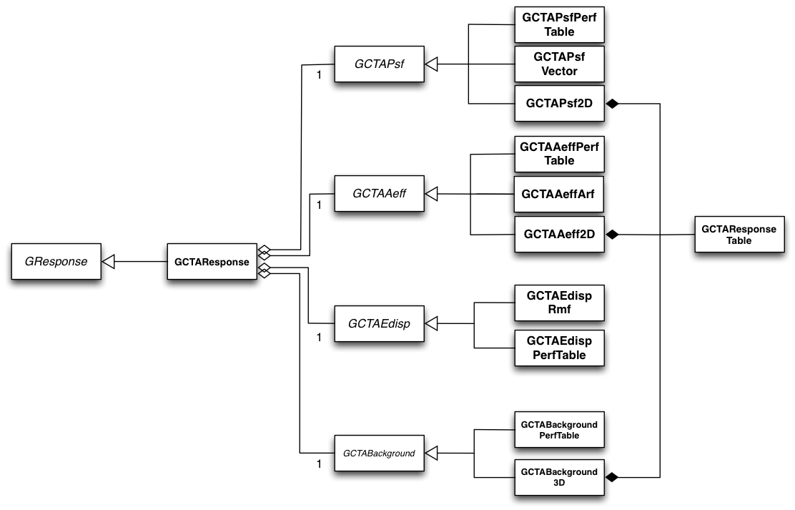
Current IRF handling
effective
area (cm2)
point spread
function
energy
dispersion
Full area, no angle cuts

Slide 39
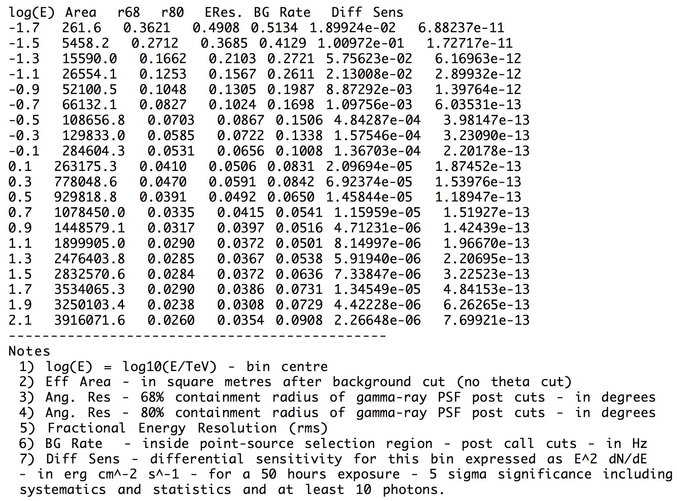
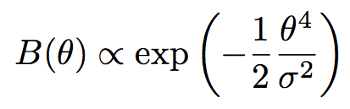
Performance tables (historic)
GCTAAeffPerfTable
GCTAPsfPerfTable
GCTAEdispPerfTable
GCTABackgroundPerfTable
Only on-axis information
A_{eff} and B_{rate} off-axis dependence modelled using
Gaussians assumed for PSF and energy dispersion

Slide 40
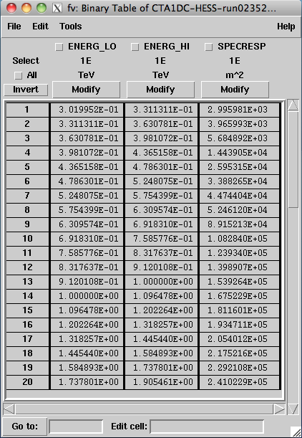
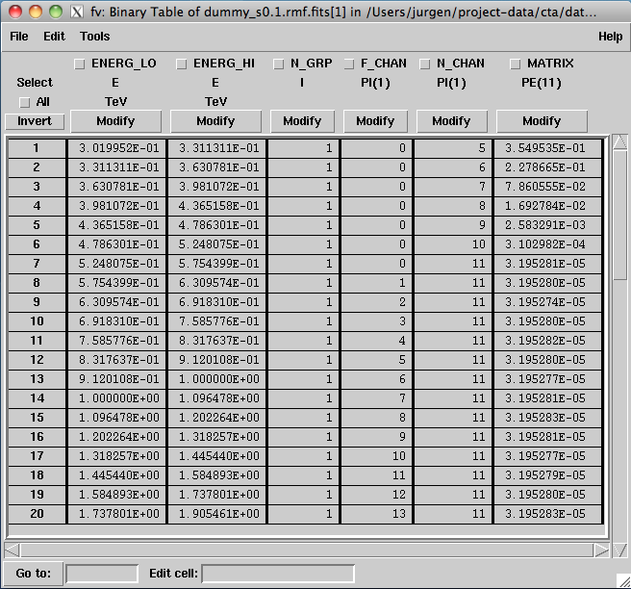
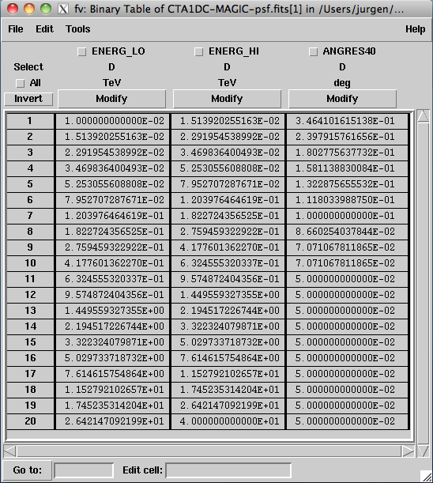
ARF, RMF, PSF vectors (1DC)
GCTAAeffArf
GCTAPsfVector
GCTAEdispRmf
Only on-axis information
A_{eff} and B_{rate} off-axis dependence modelled using
Gaussian assumed for PSF

Slide 41

Response cubes (new proposed standard)
GCTAAeff2D
GCTAPsf2D
GCTABackground3D

Slide 42

Calibration database usage
Set calibration database root:
export CALDB=/usr/local/gamma/share/caldb
mission
instrument
rspname
Specifying response as input parameters:
$ ctobssim
Model [$CTOOLS/share/models/crab.xml]
Calibration database [aar]
Instrument response function [DESY20140105_50h]
RA of pointing (degrees) (0-360) [83.63]
Dec of pointing (degrees) (-90-90) [22.01]
Radius of FOV (degrees) (0-180) [5.0]
Start time (MET in s) (0) [0.0]
End time (MET in s) (0) [1800.0]
Lower energy limit (TeV) (0) [0.1]
Upper energy limit (TeV) (0) [100.0]
Output event data file or observation definition file [events.fits]

Slide 43
Calibration database usage
Set calibration database root:
export CALDB=/usr/local/gamma/share/caldb
mission
instrument
rspname
Specifying response in XML observation definition file:
<observation_list title="observation library">
<observation name="Crab" id="00001" instrument="CTA">
<parameter name="EventList" file="events.fits"/>
<parameter name="Calibration" database="aar" response="DESY20140105_50h"/>
</observation>
</observation_list>

Slide 44
Calibration database usage
Set calibration database root:
export CALDB=/usr/local/gamma/share/caldb
mission
instrument
rspname
Specifying response within Python script:
import gammalib
obs = gammalib.GCTAObservation()
caldb = gammalib.GCaldb("cta", "aar")
irf = "DESY20140105_50h"
obs.response(irf, caldb)

Slide 45
Calibration database summary
$ cscaldb debug=yes
2014-07-04T20:56:30: +============+
2014-07-04T20:56:30: | Parameters |
2014-07-04T20:56:30: +============+
2014-07-04T20:56:30: chatter ...................: 2
2014-07-04T20:56:30: clobber ...................: yes
2014-07-04T20:56:30: debug .....................: yes
2014-07-04T20:56:30: mode ......................: ql
2014-07-04T20:56:30:
2014-07-04T20:56:30: +==============+
2014-07-04T20:56:30: | Mission: cta |
2014-07-04T20:56:30: +==============+
2014-07-04T20:56:30: === Calibration: aar ===
2014-07-04T20:56:30: DESY20140105_50h
2014-07-04T20:56:30: DESY20140105_50h_0deg
2014-07-04T20:56:30: DESY20140105_50h_180deg
2014-07-04T20:56:30:
2014-07-04T20:56:30: === Calibration: aar500 ===
2014-07-04T20:56:30: DESY20140105_50h
2014-07-04T20:56:30: DESY20140105_50h_0deg
2014-07-04T20:56:30: DESY20140105_50h_180deg
2014-07-04T20:56:30:
2014-07-04T20:56:30: === Calibration: b ===
2014-07-04T20:56:30: IFAE20120510_50h

Slide 46
Calibration file usage
Specifying response in XML observation definition file:
<observation_list title="observation library">
<observation name="Crab" id="00001" instrument="CTA">
<parameter name="EventList" file="events.fits"/>
<parameter name="EffectiveArea" file="$CALDB/data/cta/aar/bcf/DESY20140105_50h/irf.fits"/>
<parameter name="PointSpreadFunction" file="$CALDB/data/cta/aar/bcf/DESY20140105_50h/irf.fits"/>
<parameter name="EnergyDispersion" file="$CALDB/data/cta/aar/bcf/DESY20140105_50h/irf.fits"/>
<parameter name="Background" file="$CALDB/data/cta/aar/bcf/DESY20140105_50h/irf.fits"/>
</observation>
</observation_list>
Specifying response within Python script:
import gammalib
obs = gammalib.GCTAObservation()
caldb = gammalib.GCaldb("$CALDB/data/cta/aar/bcf/DESY20140105_50h")
irf = "irf.fits"
obs.response(irf, caldb)

Slide 47
Typical ctools workflows

Slide 48
ctobssim
Simulation of CTA event list based on the IRF, a source & background model, and a given pointing direction.
Does not yet consider visibility constraints.
Can simulate multiple pointings / event lists from within Python (OpenMP support).
$ ctobssim
Model [$CTOOLS/share/models/crab.xml]
Calibration database [aar]
Instrument response function [DESY20140105_50h]
RA of pointing (degrees) (0-360) [83.63]
Dec of pointing (degrees) (-90-90) [22.01]
Radius of FOV (degrees) (0-180) [5.0]
Start time (MET in s) (0) [0.0]
End time (MET in s) (0) [1800.0]
Lower energy limit (TeV) (0) [0.1]
Upper energy limit (TeV) (0) [100.0]
Output event data file or observation definition file [events.fits]
Proposed evolution:
Separate pointing definition from ctobssim (e.g. ctpntsim) to handle multiple pointings and to implement visibility constraints. Define pointing definition file (XML).

Slide 49

ctselect
Select CTA events from event file(s).
Works on individual FITS files and observation definition XML files.
$ ctselect
Input event list or observation definition file [events.fits]
RA for ROI centre (degrees) (0-360) [83.63]
Dec for ROI centre (degrees) (-90-90) [22.01]
Radius of ROI (degrees) (0-180) [3.0]
Start time (CTA MET in seconds) (0) [0.0]
End time (CTA MET in seconds) (0) [0.0]
Lower energy limit (TeV) (0) [0.1]
Upper energy limit (TeV) (0) [100.0]
Output event list or observation definition file [selected_events.fits]
Data selection keywords in FITS header
Proposed evolution:
None.

Slide 50
ctbin
Bin CTA events into 3D event cube (RA/GLON, DEC/GLAT, log₁₀ energy).
Works on individual FITS files and observation definition XML files.
Coordinate system rotation (axisrot) not yet implemented.
$ ctbin
Input event list or observation definition file [events.fits]
First coordinate of image center in degrees (RA or galactic l) [83.63]
Second coordinate of image center in degrees (DEC or galactic b) [22.01]
Algorithm for defining energy bins (FILE|LIN|LOG) [LOG]
Start value for first energy bin in TeV [0.1]
Stop value for last energy bin in TeV [10]
Number of energy bins [10]
Projection method e.g. AIT|AZP|CAR|MER|STG|TAN (AIT|AZP|CAR|MER|STG|TAN) [TAN]
Coordinate system (CEL - celestial, GAL - galactic) (CEL|GAL) [GAL] CEL
Image scale (in degrees/pixel) [0.02]
Size of the X axis in pixels [200]
Size of the Y axis in pixels [200]
Output counts map or observation definition file [cntmap.fits]
Proposed evolution:
Implement all WCS projections (GammaLib).
Implement HealPix?
Combination of several event lists into single cube? (or separate tool?)

Slide 51
ctlike
Fit parametric source & background model to events.
Binned and unbinned maximum likelihood.
Fits all GammaLib supported instrument data.
Parallel computation of multiple observations (OpenMP).
$ ctlike
Event list, counts map or observation definition file [events.fits]
Calibration database [dummy] aar
Instrument response function [cta_dummy_irf] DESY20140105_50h
Source model [$CTOOLS/share/models/crab.xml]
Source model output file [crab_results.xml]
Proposed evolution:
Implement full Hessian computation for error estimation (GammaLib).
Speed-up binned analysis (GammaLib).

Slide 52


ctmodel
Create model counts map for a given model.
Works on individual FITS files and observation definition XML files.
Specifying counts map(s).
$ ctmodel
Input counts map or observation definition file [NONE] cntmap.fits
Output counts map or observation definition file [modmap.fits]
Calibration database [$CTOOLS/share/caldb/data/cta/dummy] aar
Instrument response function [cta_dummy_irf] DESY20140105_50h
Source model [$CTOOLS/share/models/crab.xml]
cntmap.fits
modmap.fits
Proposed evolution:
None.

Slide 53
ctskymap
Bin CTA events into 2D sky map (RA/GLON, DEC/GLAT).
Basically 2D version of ctbin.
Works on individual FITS files only.
Coordinate system rotation (axisrot) not yet implemented.
$ ctskymap
Output file name [skymap.fits]
Event data file name [events.fits]
First coordinate of image center in degrees (RA or galactic l) [83.63]
Second coordinate of image center in degrees (DEC or galactic b) [22.01]
Minimum energy in TeV [0.1]
Maximum energy in TeV [100.0]
Projection method e.g. AIT|AZP|CAR|MER|STG|TAN (AIT|AZP|CAR|MER|STG|TAN) [CAR]
Coordinate system (CEL - celestial, GAL - galactic) (CEL|GAL) [CEL]
Image scale (in degrees/pixel) [0.02]
Size of the X axis in pixels [200]
Size of the Y axis in pixels [200]
Proposed evolution:
Combination of several event lists into single map.
Implement imaging algorithms (e.g. ring background, template background, …)
Implement all WCS projections (GammaLib).
Implement HealPix?

Slide 54
4. Goals of this sprint

Slide 55

Goals of this sprint

Slide 56

Agenda

